Slide 1
Technology and AI at USC:
First Steps for New Faculty
eLearning Services and Garnet AI Foundry

Slide 2
What New Faculty Need to Know First
Know what each core tool is for and when students will encounter it
Confirm access before the semester pace accelerates
Use the right support pathway instead of troubleshooting alone
DoIT, eLearning Services, CTE, and the AI Educators can connect you to the right resource for course setup, communication, classroom technology, and responsible AI use.
You do not need to master every platform today.

Slide 3
Core Platforms at a Glance
PART 1
Platform | What it is | Why it matters | Where to get help
Blackboard | Course site, content, assignments, grades | Primary digital home for many courses | help.blackboard.com; go.sc.edu/BlackboardHelp; Service Desk
Zoom | Live online meetings and virtual office hours | Supports synchronous access and meetings | DoIT resources; CTE workshops
Panopto | Lecture capture and video hosting | Houses course recordings and reusable video | Panopto guide; CTE workshops
Explorance Blue | Course experience surveys and reports | Collects course feedback and supports reporting | Provost Blue resources; training
Source: USC Division of Information Technology, CTE, and Office of the Provost support pages.
Notes:
Time: 3 minutes.
Walk the audience across the table left to right: first what each platform is, then why it matters in the first few weeks, then where to begin if something does not work.
Keep the emphasis practical. Blackboard is the course management anchor, Zoom supports live sessions and meetings, Panopto hosts recordings, and Explorance Blue supports course experience surveys and reporting.

Slide 4
First Week Faculty Checklist
PART 1
Start with access, communication, and support.
1
Confirm access to Blackboard course sites
4
Check Zoom and Panopto access if using live or recorded content
2
Upload or review syllabus materials
5
Confirm where students should go for technology help
3
Decide how students should communicate with you
6
Bookmark core support pages and service channels
Tip: review platform-specific accuracy with eLearning Services or other campus support owners before distribution.
Notes:
Time: 3 minutes.
Use this slide as a practical first-week checklist. The sequence is access first, then student-facing materials, then communication expectations, then support paths.
Note for presenters: this checklist is a recommended structure and should be reviewed by the appropriate platform owners for final accuracy before the session or handout is distributed.

Slide 5
Where to Get Support
PART 1
Technical help
Teaching support
Training resources
IT Service Desk
Self-service portal / IT ticket
Blackboard, Zoom, Panopto help pages
CTE workshops and consultations
eLearning Services guidance
Online, hybrid, and blended course design support
Blackboard Learn Ultra sessions
Zoom and Panopto sessions
Digital accessibility resources
If you are unsure where to start, begin with the IT Service Desk, CTE, or eLearning Services; they can route you.
DoIT Service Desk: 803-777-1800 | USC DoIT and CTE support pages
Notes:
Time: 4 minutes.
Explain that support is organized by type of need. Use DoIT and the IT Service Desk for technical access and platform issues. Use CTE and eLearning Services for teaching design, Blackboard use in courses, online learning, and workshops.
Invite faculty to ask for routing help if they are not sure which group owns a problem. The key is to ask early rather than waiting until a course issue becomes urgent.

Slide 6
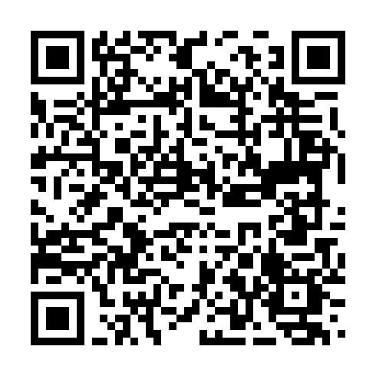
AI at USC: The Simple Version
PART 2
The Garnet AI Foundry is USC’s AI tools, training, and support hub.
Tools
Training
Garnet AI
Foundry
Use approved AI services and university guidance as your starting point
Look to the Foundry for resources, workshops, and support pathways
Start with practical use cases: productivity, course planning, brainstorming, feedback workflows, and responsible experimentation
Support
Practice
Visit the Garnet AI Foundry
Notes:
Time: 2 minutes.
Frame AI at USC in one sentence: start with the Garnet AI Foundry. It is the central place for approved resources, training, support, and guidance.
Keep examples low-risk and practical. Faculty can begin with brainstorming, drafting, summarizing, course planning, and workflow support while keeping university policies and privacy expectations in mind.

Slide 7
What Faculty Can Do with USC AI Tools
PART 2
Practical, low-risk starting points
From one task to repeatable support
Draft and refine course communications
Brainstorm assignment ideas or discussion prompts
Summarize meeting notes or planning materials
Generate first drafts of rubrics, activities, or FAQs
Explore custom GPTs or agents for repeated instructional or administrative tasks
Try a single prompt
1
2
Refine with examples
3
Build a reusable workflow
Notes:
Time: 3 minutes.
Give examples that are useful but low-risk: drafting routine communications, brainstorming prompts, summarizing planning notes, producing a first draft of a rubric or FAQ, and exploring repeated workflows.
Stress that AI output is a starting point. Faculty still own the review, adaptation, accuracy, tone, and instructional decision.

Slide 8
Responsible AI Use: Guardrails for Faculty
PART 2
Use approved tools
Start with USC-supported AI services when working with university information.
Protect sensitive data
Do not put sensitive student, employee, health, or protected data into unapproved tools.
Review outputs
Check accuracy, bias, citations, and fit before using or sharing AI-generated work.
Be transparent
Tell students when AI is part of the learning process or assignment workflow.
Keep judgment human
AI can assist; faculty remain accountable for academic and professional decisions.
Notes:
Time: 3 minutes.
Use plain language. Approved tools and privacy come first, especially when working with student or employee information. Remind faculty not to enter protected or sensitive data into unapproved tools.
Then emphasize professional judgment: AI outputs require review for accuracy, bias, and context. Transparency with students and human oversight are the recurring themes.

Slide 9
Before you paste: what data is OK where?
PART 2
Type of information | Microsoft Copilot | ChatGPT Edu | Unsupported AI Tools | Guidance
Public or low-risk content | Yes | Yes | Yes, if no PII or proprietary university data is being used | Appropriate for drafting, brainstorming, and summarizing
General work notes with no sensitive details | Yes | Yes | Use caution to ensure any proprietary university data is not being accessed | Remove unnecessary identifiers
Student information or FERPA-protected data | Yes | Follow university guidance and minimum-necessary practices | No | When unsure, do not paste
Employee, HR, financial, or identifiable records | Only if approved and appropriate to policy | Only if approved and appropriate to policy | No | Check with leadership or data owner first
Restricted or confidential information | Use caution and policy guidance | Do not paste | No | Pause and verify before using AI

Slide 10




Privacy & Ethics
PART 2
PRIVACY
SECURITY
BIAS & FAIRNESS
ACCESSIBILITY
Treat student data as FERPA-protected.
Mitigate risk when possible.
Use approved tools; enable MFA.
Don’t upload restricted docs into tools when limitations aren’t clear without speaking to leadership.
Check for bias; prompt for diverse examples.
Ask for plain language; verify accessibility.
Check final outputs against.

Slide 11
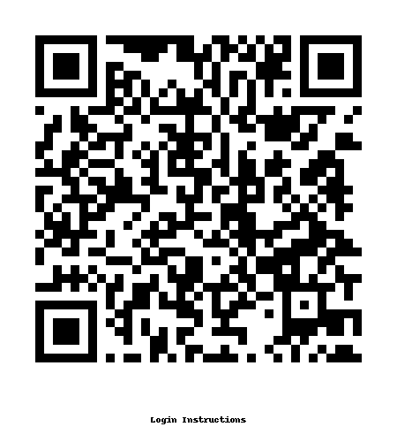
How to Access USC ChatGPT Edu
PART 2
Go to https://go.sc.edu/chatgptlogin or chatgpt.com and select Log in
Use your USC email ending with @email.sc.edu, @mailbox.sc.edu, or @sc.edu
Choose the "univsouthcarolina-edu" login method
Enter your USC username and password on the CAS page
Complete Duo Mobile authentication approval
Confirm login by seeing USC logo at bottom left
Follow same steps on browsers and ChatGPT app for mobile users

Slide 12
Sustainability: A Better Way to Talk about AI Use
PART 2
Reframing the “3 Rs” for AI Use
Reduce
Use AI intentionally through effective prompting
Refine
Improve prompts instead of rerunning tools endlessly
Reflect
Decide whether AI is needed at all

Slide 13
Our Commitment: The Full Picture
PART 2
Ethical, Environmental, and Human Impacts
The AI Educators emphasize:
Ethical considerations (bias, transparency, responsibility)
Environmental costs of AI systems
Human agency and choice
Our Goal:
Equip students, faculty, and students with context so they can make informed decisions – not just efficient ones.

Slide 14
How the AI Educators Can Help
PART 2
A practical partner for responsible AI adoption
Workshops
Learn concepts, tools, and practical prompting approaches.
Custom GPT / agent support
Explore repeated workflows that may benefit from a tailored assistant.
Consultations
Talk through teaching, research, or operational use cases.
Tool routing
Connect with the right AI platform or practice for your goal.
Guides and resources
Find examples, recommendations, and training materials.
Start with a question or workflow, not a tool name.
The AI Educators can help translate goals into safe, useful next steps.
Notes:
Time: 2 minutes.
Describe the AI Educators as a support team for thoughtful AI integration. Their services include workshops, consultation, guides, custom GPT or agent support, and help connecting people to appropriate DoIT-supported AI platforms.
Encourage faculty to bring a practical use case: a course communication pattern, feedback workflow, planning task, or administrative routine.

Slide 15
Your First Three Actions After Today
PART 3
1
Bookmark support paths
2
Check access
3
Request help early
Save academic technology and AI support pages, plus contact channels you can find again quickly.
Log into Blackboard, Zoom, Panopto, and USC-supported AI tools before you need them in class.
Ask for guidance if you want to explore AI for course design, communication, assignments, or workflow support.
The goal is momentum: confirm the basics now, then use campus experts for the next layer of support.
Notes:
Time: 4 minutes.
Close with action. Ask faculty to bookmark support pages, check access to the main teaching technologies and AI tools, and request help early.
Reinforce that the best time to solve access and setup questions is before the semester starts or before an assignment depends on the tool.

Slide 16
Contacts and Resources
Academic technology
AI resources
DoIT IT Service Desk: 803-777-1800
Blackboard Help: go.sc.edu/BlackboardHelp
Zoom & Panopto resources through DoIT
eLearning Services workshops and support pathways
Garnet AI Foundry
AI Educators workshops and consultations
USC-supported AI tool guidance
One-page guide: share final link with participants
Notes:
Time: 3 minutes.
Use this slide to point faculty to follow-up resources and contacts. Mention that the final one-page guide should include current links and contact paths for DoIT, eLearning Services or academic technology support, CTE, the Garnet AI Foundry, and AI Educators.
Reference links for handout preparation include USC DoIT faculty/staff resources, Blackboard help, Zoom and Panopto resources, CTE workshops, and Garnet AI Foundry faculty and training pages.

