Slide 1
Supportive Classroom environments at USC
New Faculty Orientation
August 28, 2026

Slide 2
Presenters
THE CENTER FOR TEACHING EXCELLENCE
Kristin Harrell and Mitchell Dallas Herring
Instructional Designers
THE STUDENT CARE AND OUTREACH TEAM
Austin LaForest – Director of Student Care and Case Management
Alisa Liggett – Assistant Dean of Students
Liliann Pineda- Care Team Coordinator

Slide 3
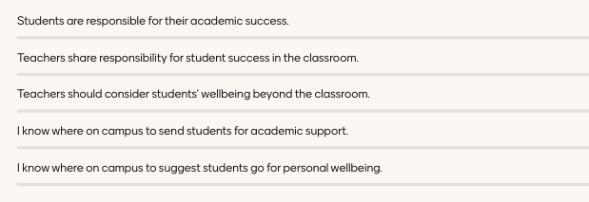
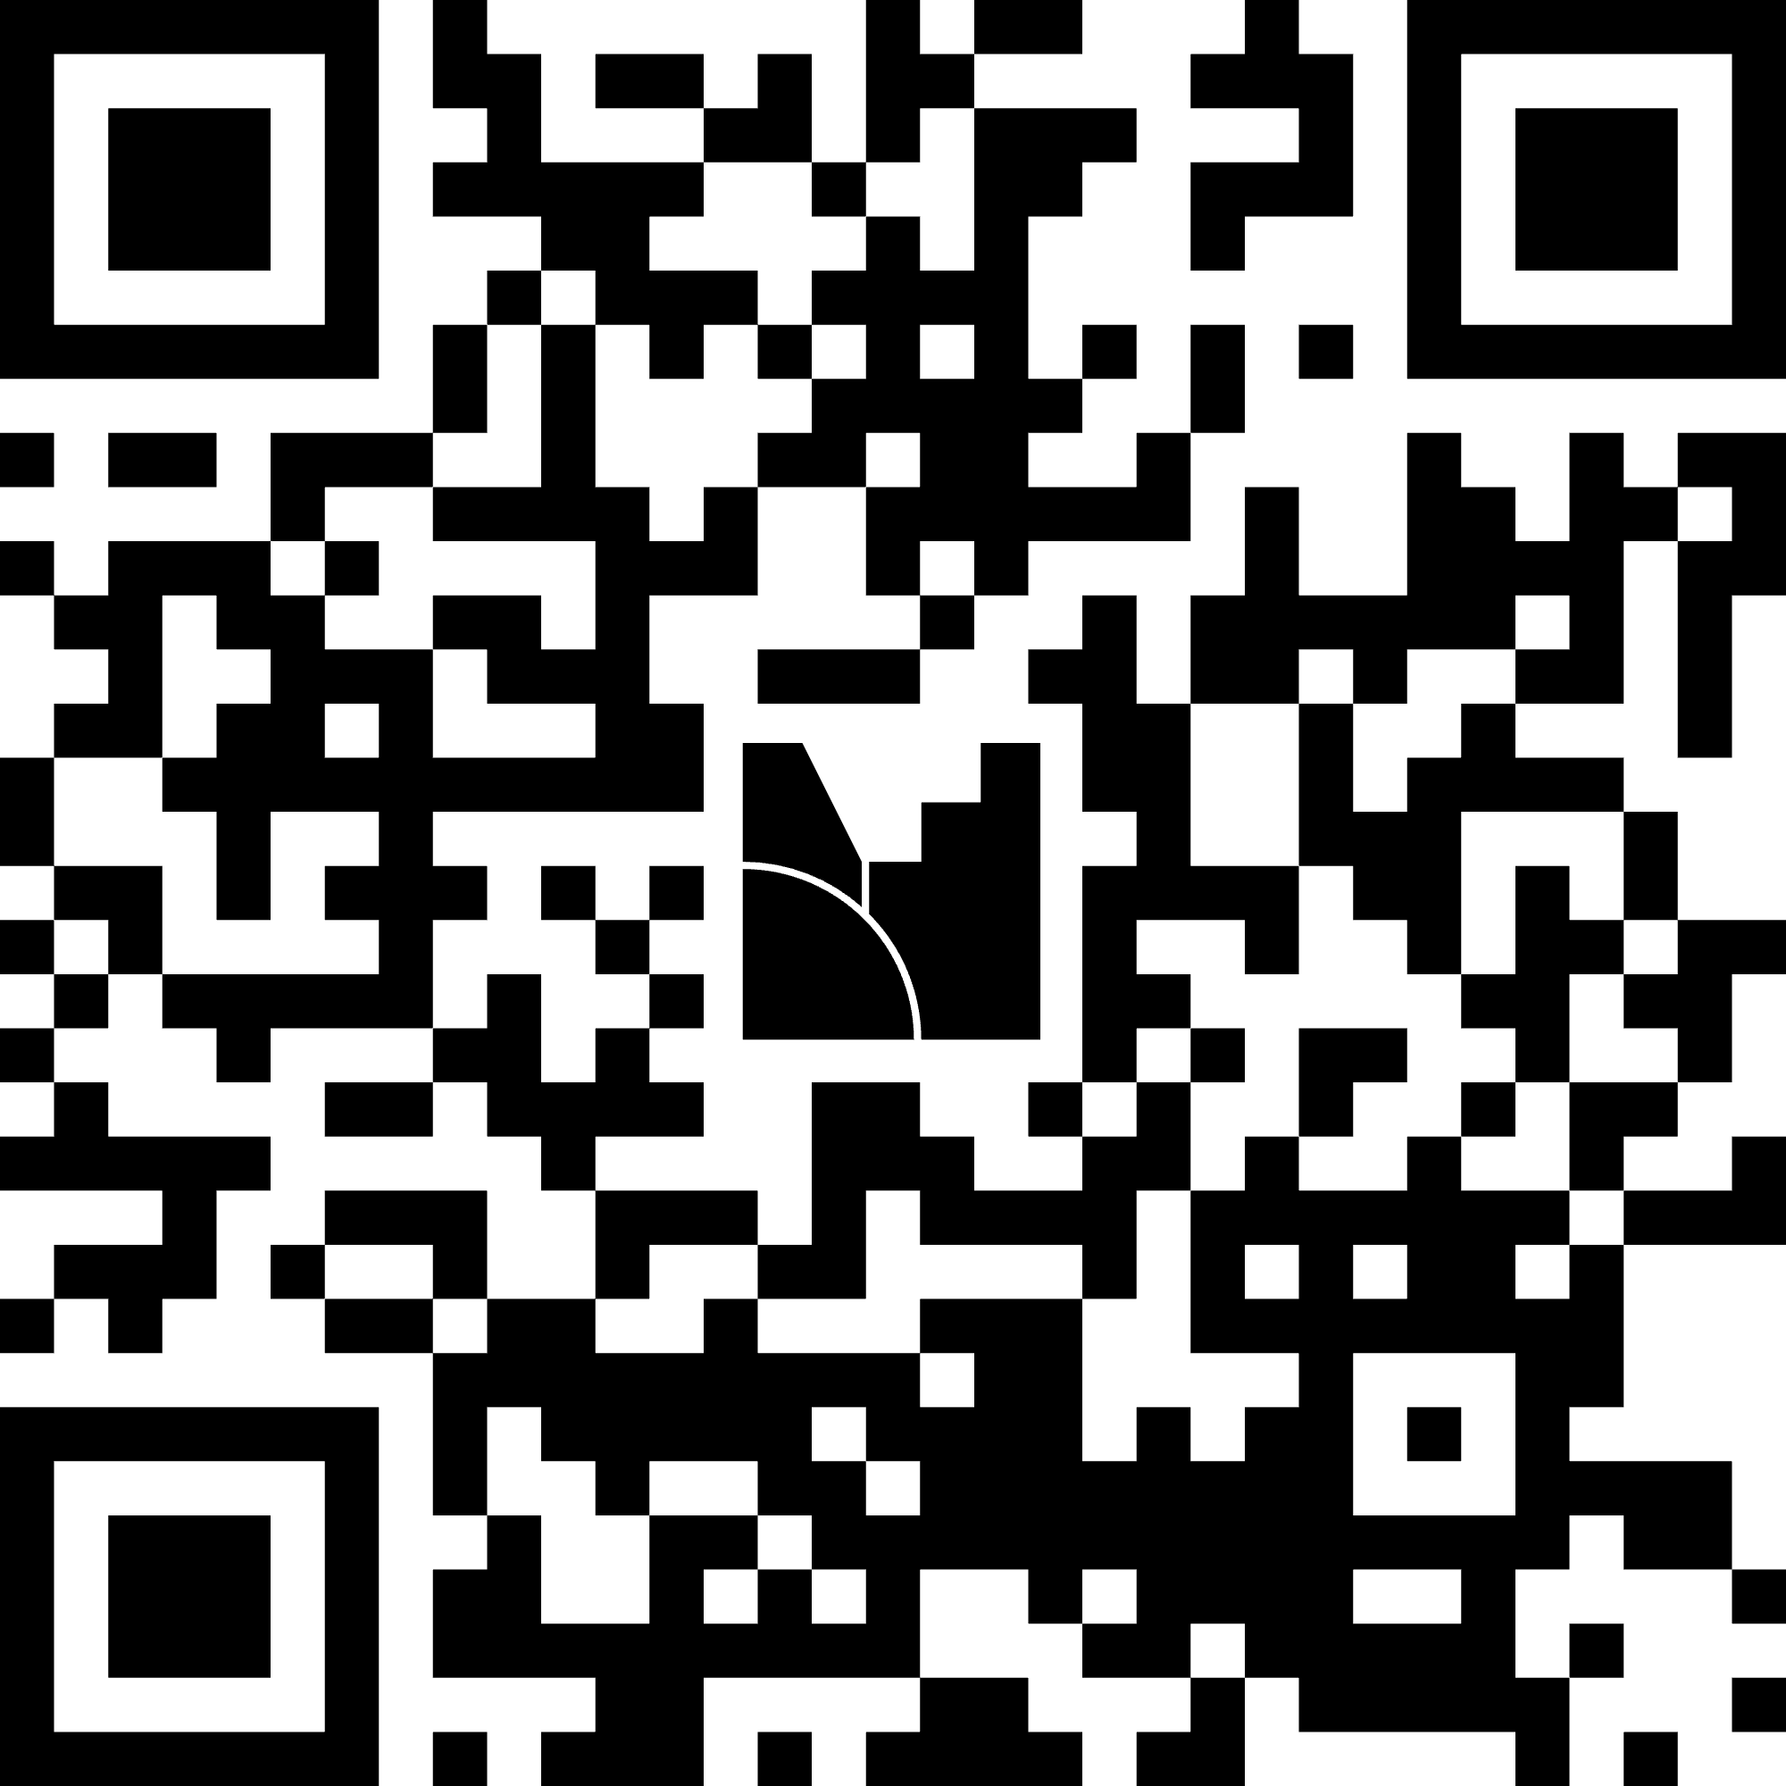
What role does faculty play in student success?
QR CODE FOR MENTIMETER

Slide 4



Academic Success
Student Success
Center
Career Center
Student Affairs &
Academic Support

Slide 5




A FIRST TIME FOR EVERYONE
International Student & Scholar Support
University 101
First-Generation
Center

Slide 6

Support for
Students in transition
Shifts in academic direction (e.g., major changes)
Institutional movement (e.g., transfer pathways)
Advancement to graduate or professional education
Preparation for and transition into the workforce
Re-entry or re-engagement with higher education
The National Resource Center
for the FYE & Students in Transition

Slide 7
ACADEMIC CONCERNs
Withdrawal Support Needed?
If a student is failing and professor's recommendation is that they withdraw from the class
  Withdrawal webpage
Temporary Condition or Injury?
  Temporary Conditions and Injuries (TCI) assistance
Absent? Disengaged? Failing?
  Student Success
Cheating? Disruptive Behavior?
  Office of Student Conduct and Academic Integrity
Absence Verification?
  Office of Student Advocacy

Slide 8
But what about when it seems like something more personal?
Questions you might ask:
Is it my business?
Am I allowed to say anything?
Is it my responsibility?
How do I even bring up the subject?
Will they be offended?
Will it damage my relationship with my students?

Slide 9

Student care and outreach team referring students of concern
Austin LaForest – Director of Student Care and Case Management
Alisa Liggett – Assistant Dean of Students
Liliann Pineda- Care Team Coordinator
Notes:
ACL 1-6
AL – 7-11
ACL 12-17
AL 18-21
We typically employ 12-15 in OSCAI, and embarrassingly are the lowest paying, but gratefully with a remarkable retention. Used to honest conversations and committed to giving them important work, not busy work.
Thank them for being helpers
Person and professional

Slide 10
Goals of the care team
Multidisciplinary team that meets weekly to discuss students of concern
Addresses individual student behavioral issues that impact student well-being and sometimes the campus community
Positive and productive way to initiate intervention
Case by case approach
Reduces the risk of fragmented care and serving as a clearinghouse for concerns about students in distress
Notes:
ACL

Slide 11
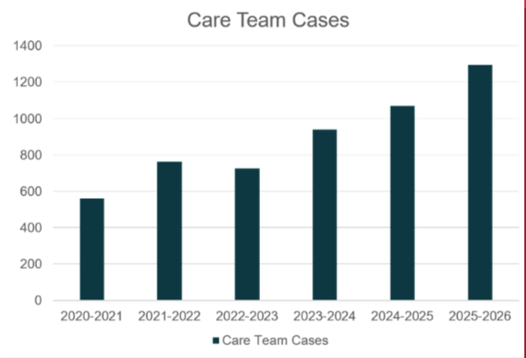
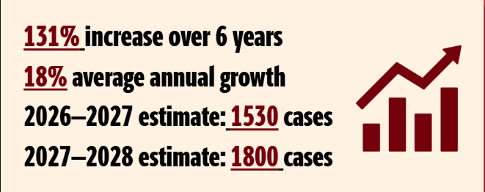
CARE TEAM CASES
Notes:
1,235 for Fall-Spring. Increase over the summer

Slide 12
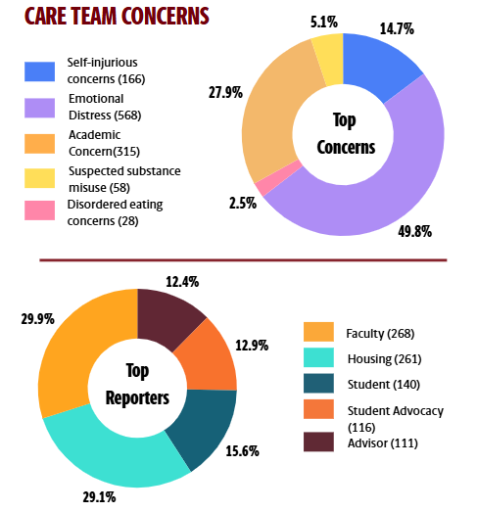
CARE TEAM CONCERNS
Notes:
1,235 for Fall-Spring. Increase over the summe

Slide 13
SIGNS OF DISTRESS IN STUDENTS
Eating or sleeping too much or too little
Pulling away from people and things
Having low or no energy
Unexplained aches and pains
Feeling helpless or hopeless
Excessive substance use, including prescription medications
Worrying a lot of the time; feeling guilty but not sure why
Thinking of hurting yourself or someone else
Having difficulty readjusting to work or home life

Slide 14
WARNING SIGNS IN THE CLASSROOM
Aggressive behaviors
Disengagement
Changes in behaviors/appearances
Spontaneous academic changes
Tone of reflective writing
Consistently late or disheveled
Academic integrity issues
Social media concerns
Decreased performance in rotations
Classmate concerns
Death of a relative, friend or pet
Relationship issues
Unexplainable guilt
Deteriorating academic performance
Frequent negative emotions

Slide 15
SKILLS PRACTICE
Use Talking Points
Plan out what to say
Keep notes via email to Dean's office on students of concern
Practice saying:
  “I’ve noticed some changes, I’m concerned and want to talk to you about it, is everything ok?”
  “I’ve noticed you have missed classes. This is impacting your grade and I’m worried about you. How are you doing?”
  “Have you considered going to the counseling center?”
  “Have you thought about suicide?”

Slide 16
SKILLS PRACTICE 1
What might you say to a student that displayed behaviors you found concerning?
  Brainstorm ideas at your table
  Opportunity to share out
How might you share with a student that you think the Care Team could be helpful and that you plan to refer them?

Slide 17
SKILLS PRACTICE 2
Opening: "I've noticed that you haven't turned in any of the quizzes on blackboard, have been missing labs, and are falling asleep in class. I'm wondering if you could tell me about what's going on? I'm a bit worried.
Validation: "It sounds like you're struggling in a way that's making school feel almost impossible right now"
Pivoting to resource connection:
  I had some students last year who we're going through something similar, do you mind if I share with you what worked for them?
  From what I am hearing you just feel super overwhelmed by coursework, your parents' divorce, and keeping your LIFE scholarship. I wonder if you'd ever consider counseling to really dig deeper into all these stressors?

Slide 18
PRACTICES TO CREATE A SENSE OF BELONGING AND TRUST
1st day note cards - identify two biggest concerns
Question of the day
Flower Darby's recommendations for on-line options:
  Record a quick video talking about how you want them to succeed, and your support for them as a student and as a human (Educause 2017 tech/teaching)
  Have them record a quick check-in video
  Check-ins (informal during class and in 1:1s)
Clear Expectations/Outcomes
Communicate with stakeholders: Dean’s Office, Withdrawal Coordinator, Care Team, TCI
  Offer consultations to students for withdrawals, including hardships, and TCI
Reflective questions on assignments/midterms
  What else do I need to know about you? How are you doing?
Mental health topic day/ Conference absence day – Care Team or Mental Health Initiatives
After hours planning

Slide 19
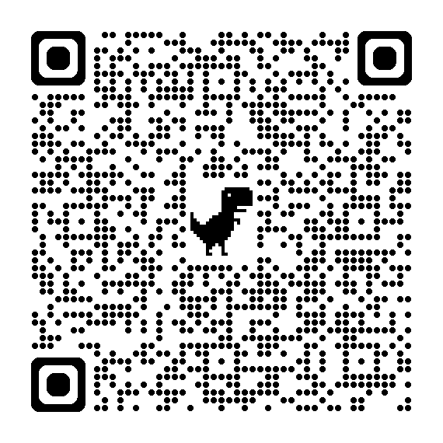
How to reach us
Phone: 803-777-4193
Email: careteam@mailbox.sc.edu
Website sc.edu/careandoutreach
  Schedule a consultation
  Submit a referral
Notes:
AL

Slide 20
Embedding Resources
Normalizing Access
Reducing Barriers
Maintaining Boundaries

Slide 21
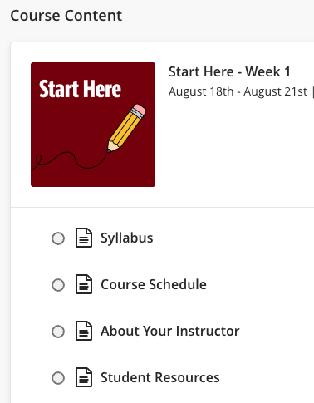
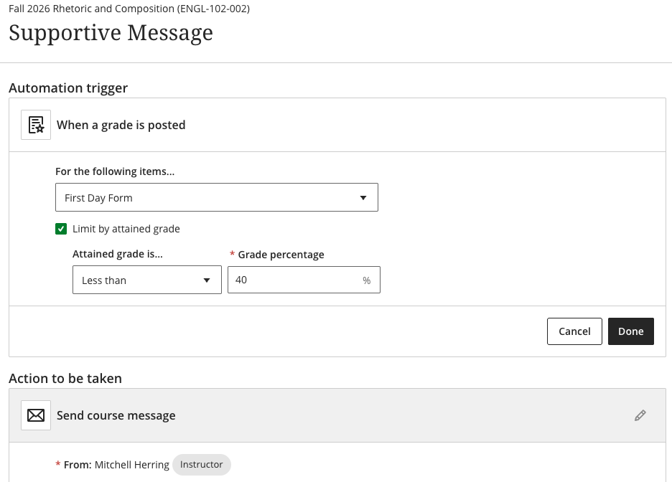
Easy Embedding

Slide 22
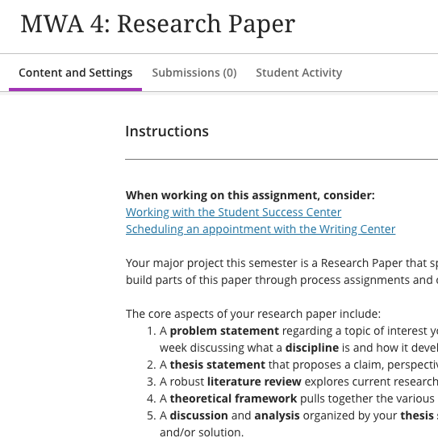
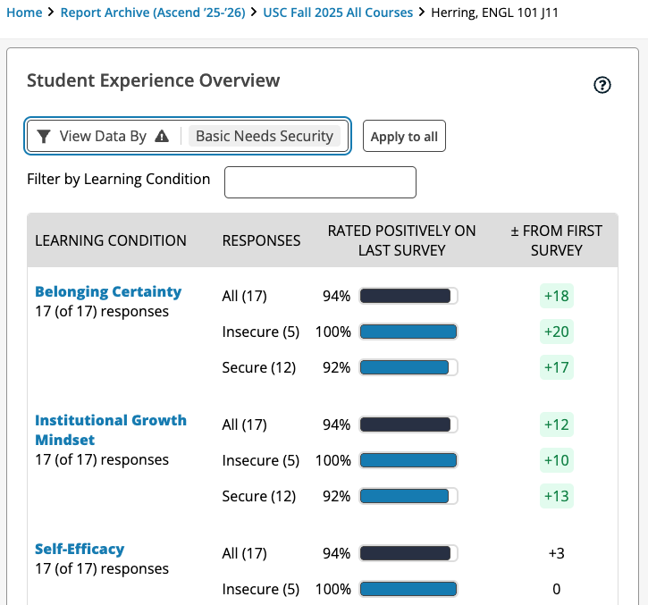
Other Methods

Slide 23
Programs
Student Experience Project: A national project focused on developing a supportive, growth mindset through discrete teaching practices.
Carolina Experience Programming: The Carolina Experience office follows students throughout their program of study, including the transfer, sophomore, junior and senior year experience. The Mutual Expectations opportunities connect faculty and students through guided dialogue and discussion. Carolina Experience has collaborated with CTE on the Understanding USC Student Populations certificate to support faculty in holistically supporting students.

Slide 24
Thank you!
New Faculty Orientation
August 28, 2026

