Slide 1

Navigating the usc research ecosystem
Lumi Bakos, PhD, Associate Vice President for Research
Emily Devereux, DPA, CRA, Associate Vice President for Research
Steve Schrimpf, Chief Research Security Officer

Slide 2
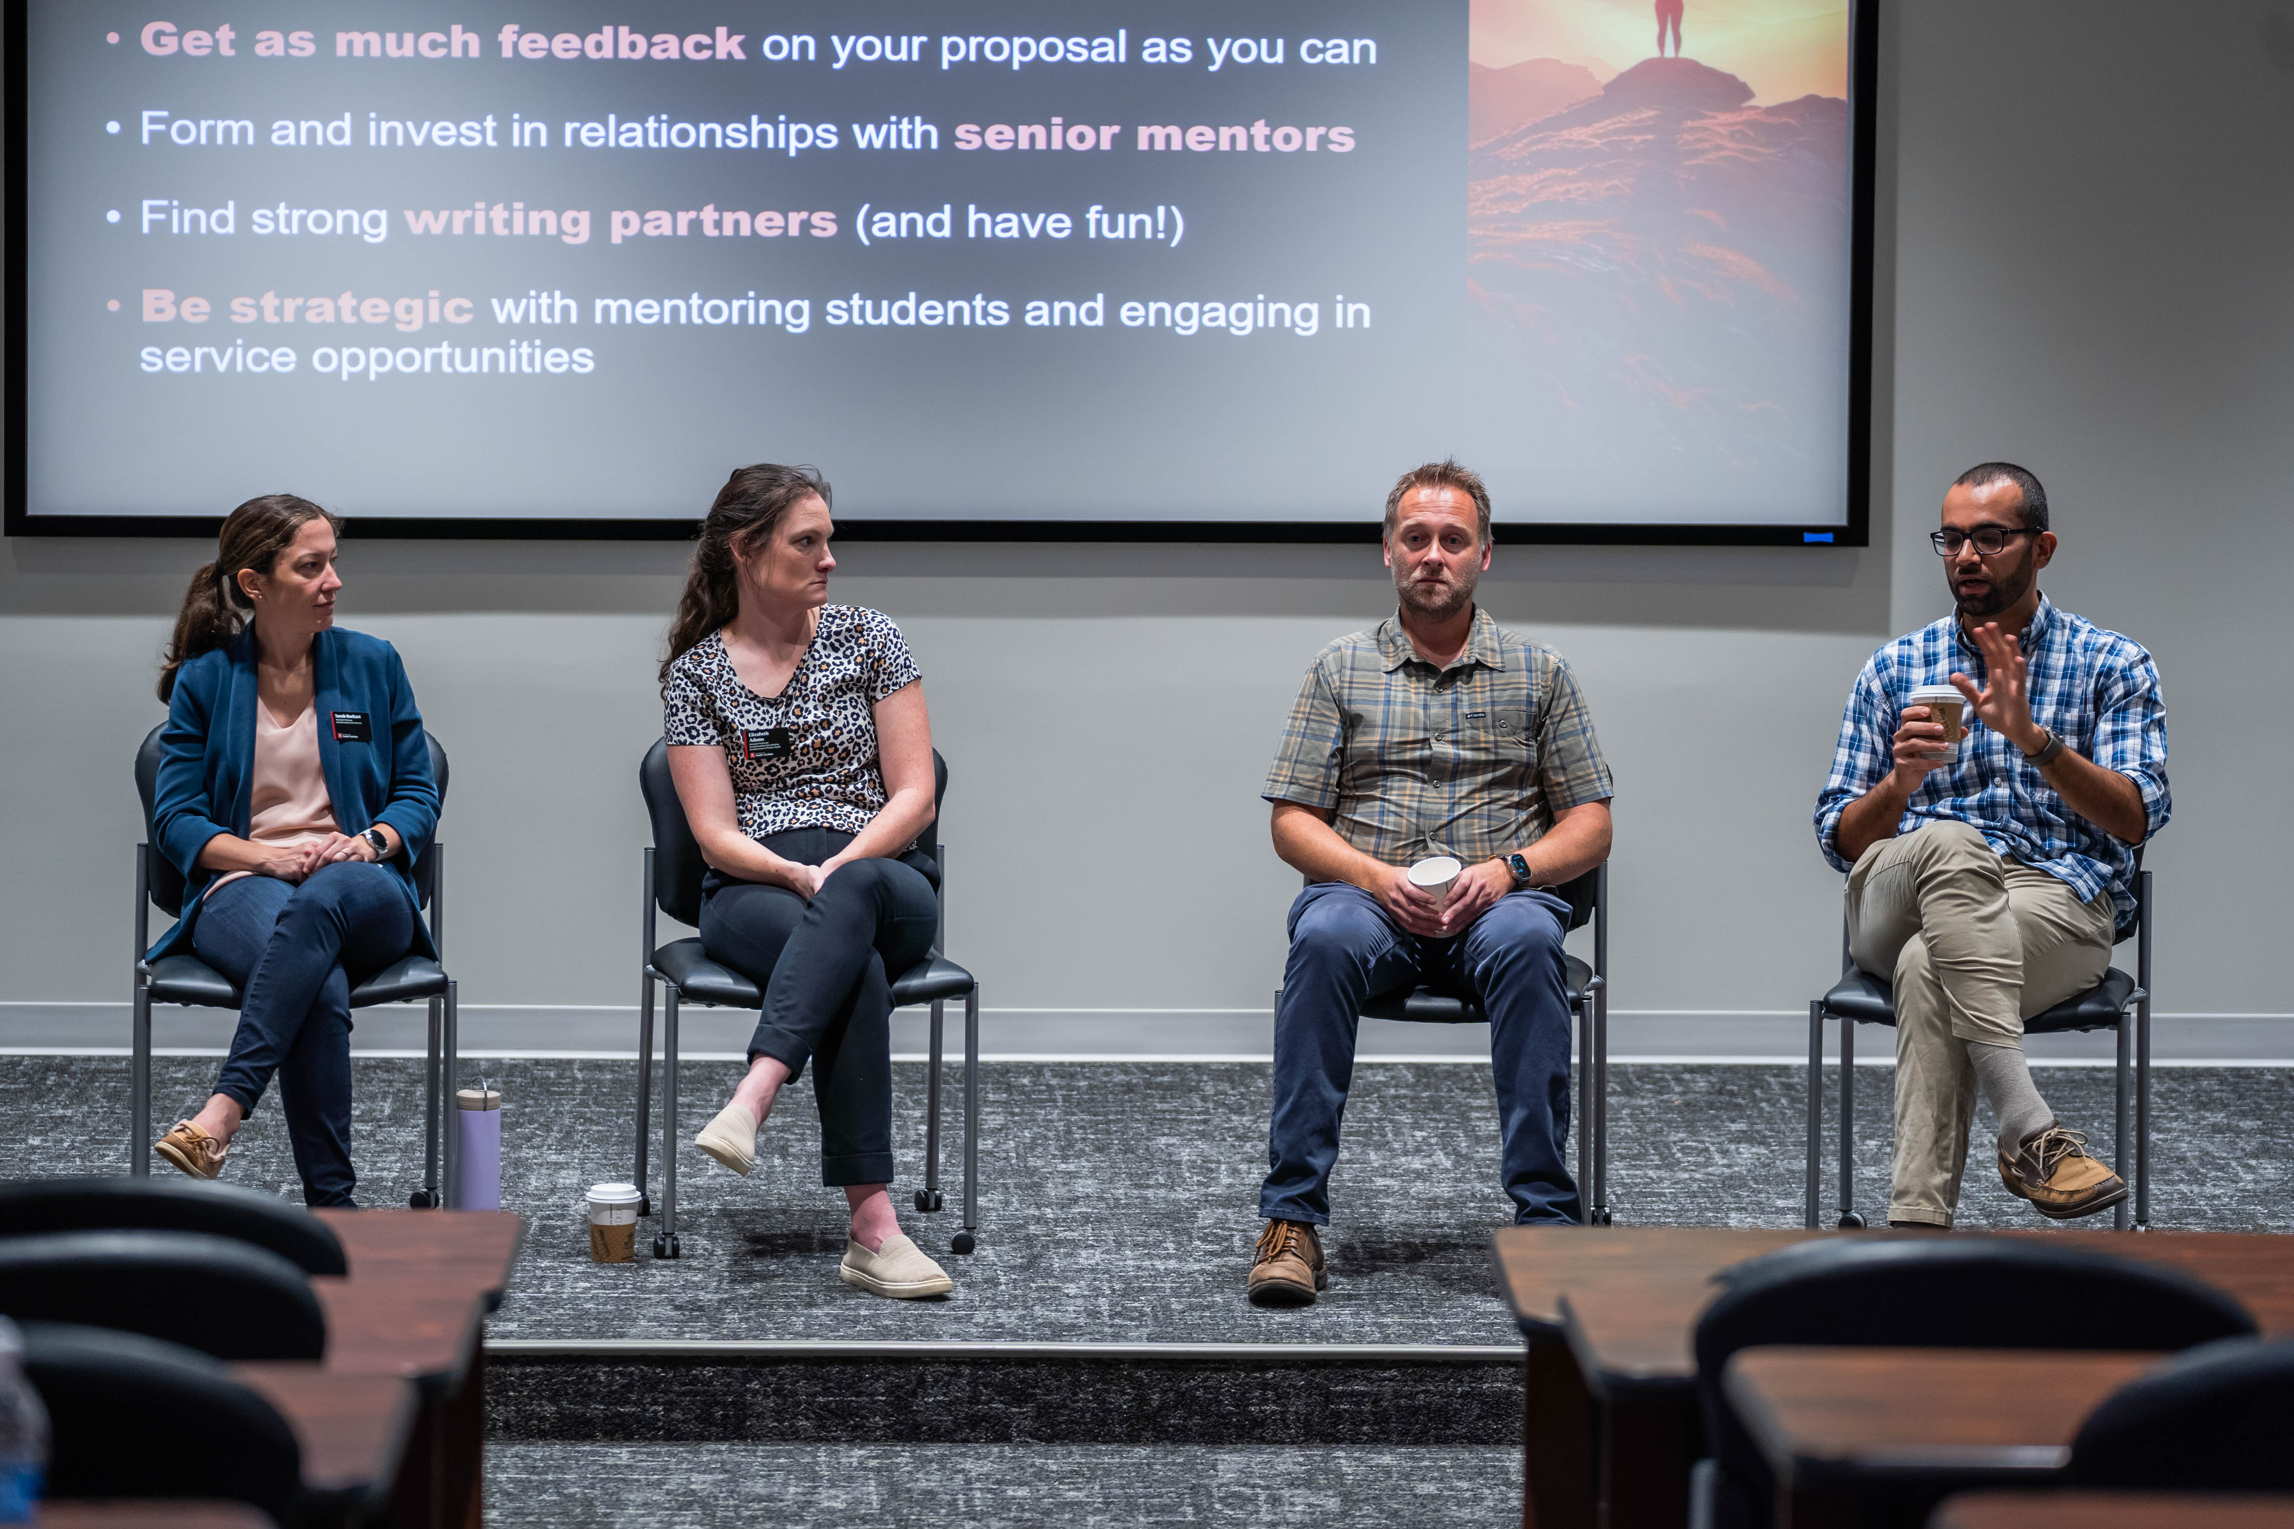
USC Office of Research
USC Research Advantage: Faculty Resources & Services
Demystifying the grant proposal process at USC
Research development & enhancement services
Faculty research training programs for PIs
Collaborative research networking at USC
Leveraging research infrastructure through USC Research Cores
Partnering with Office of Undergraduate Research
Research Security & other USC critical research resources

Slide 3
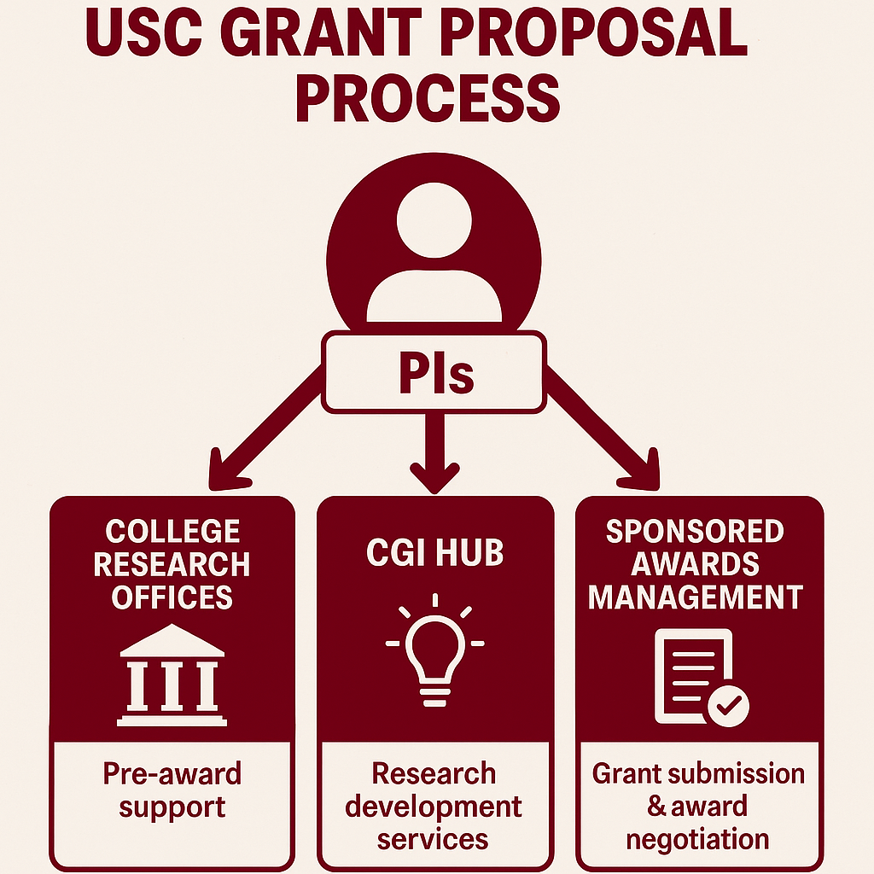
USC
Proposal Development & Submission Partners

Slide 4
Carolina Grants & Innovation Hub
  Increase USC research competitiveness
  Foster a more productive research environment through a wholistic approach to research training
  Be a centralized hub for innovative programs, resources, and services for faculty and research administration

Slide 5
Key Proposal Development Services
Funding prospecting
Institutional boilerplate language and documents
Proposal checklists and submission requirements
Budget and budget justification services
Technical editing assistance
Graphic design services
University Libraries services with data management and sharing plans
External reviews

Slide 6
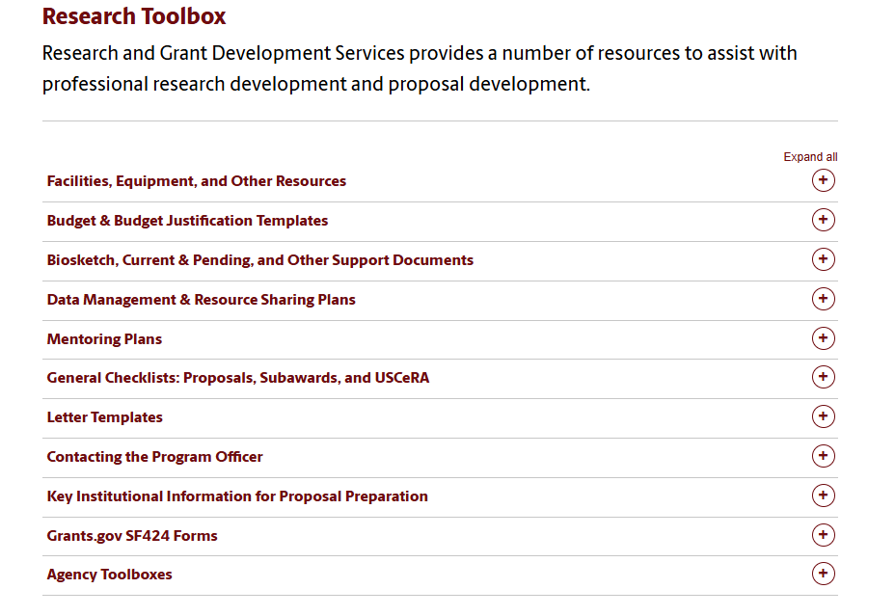
Research Toolbox
https://www.sc.edu/about/offices_and_divisions/research_and_grant_development/research-toolbox/index.php

Slide 7
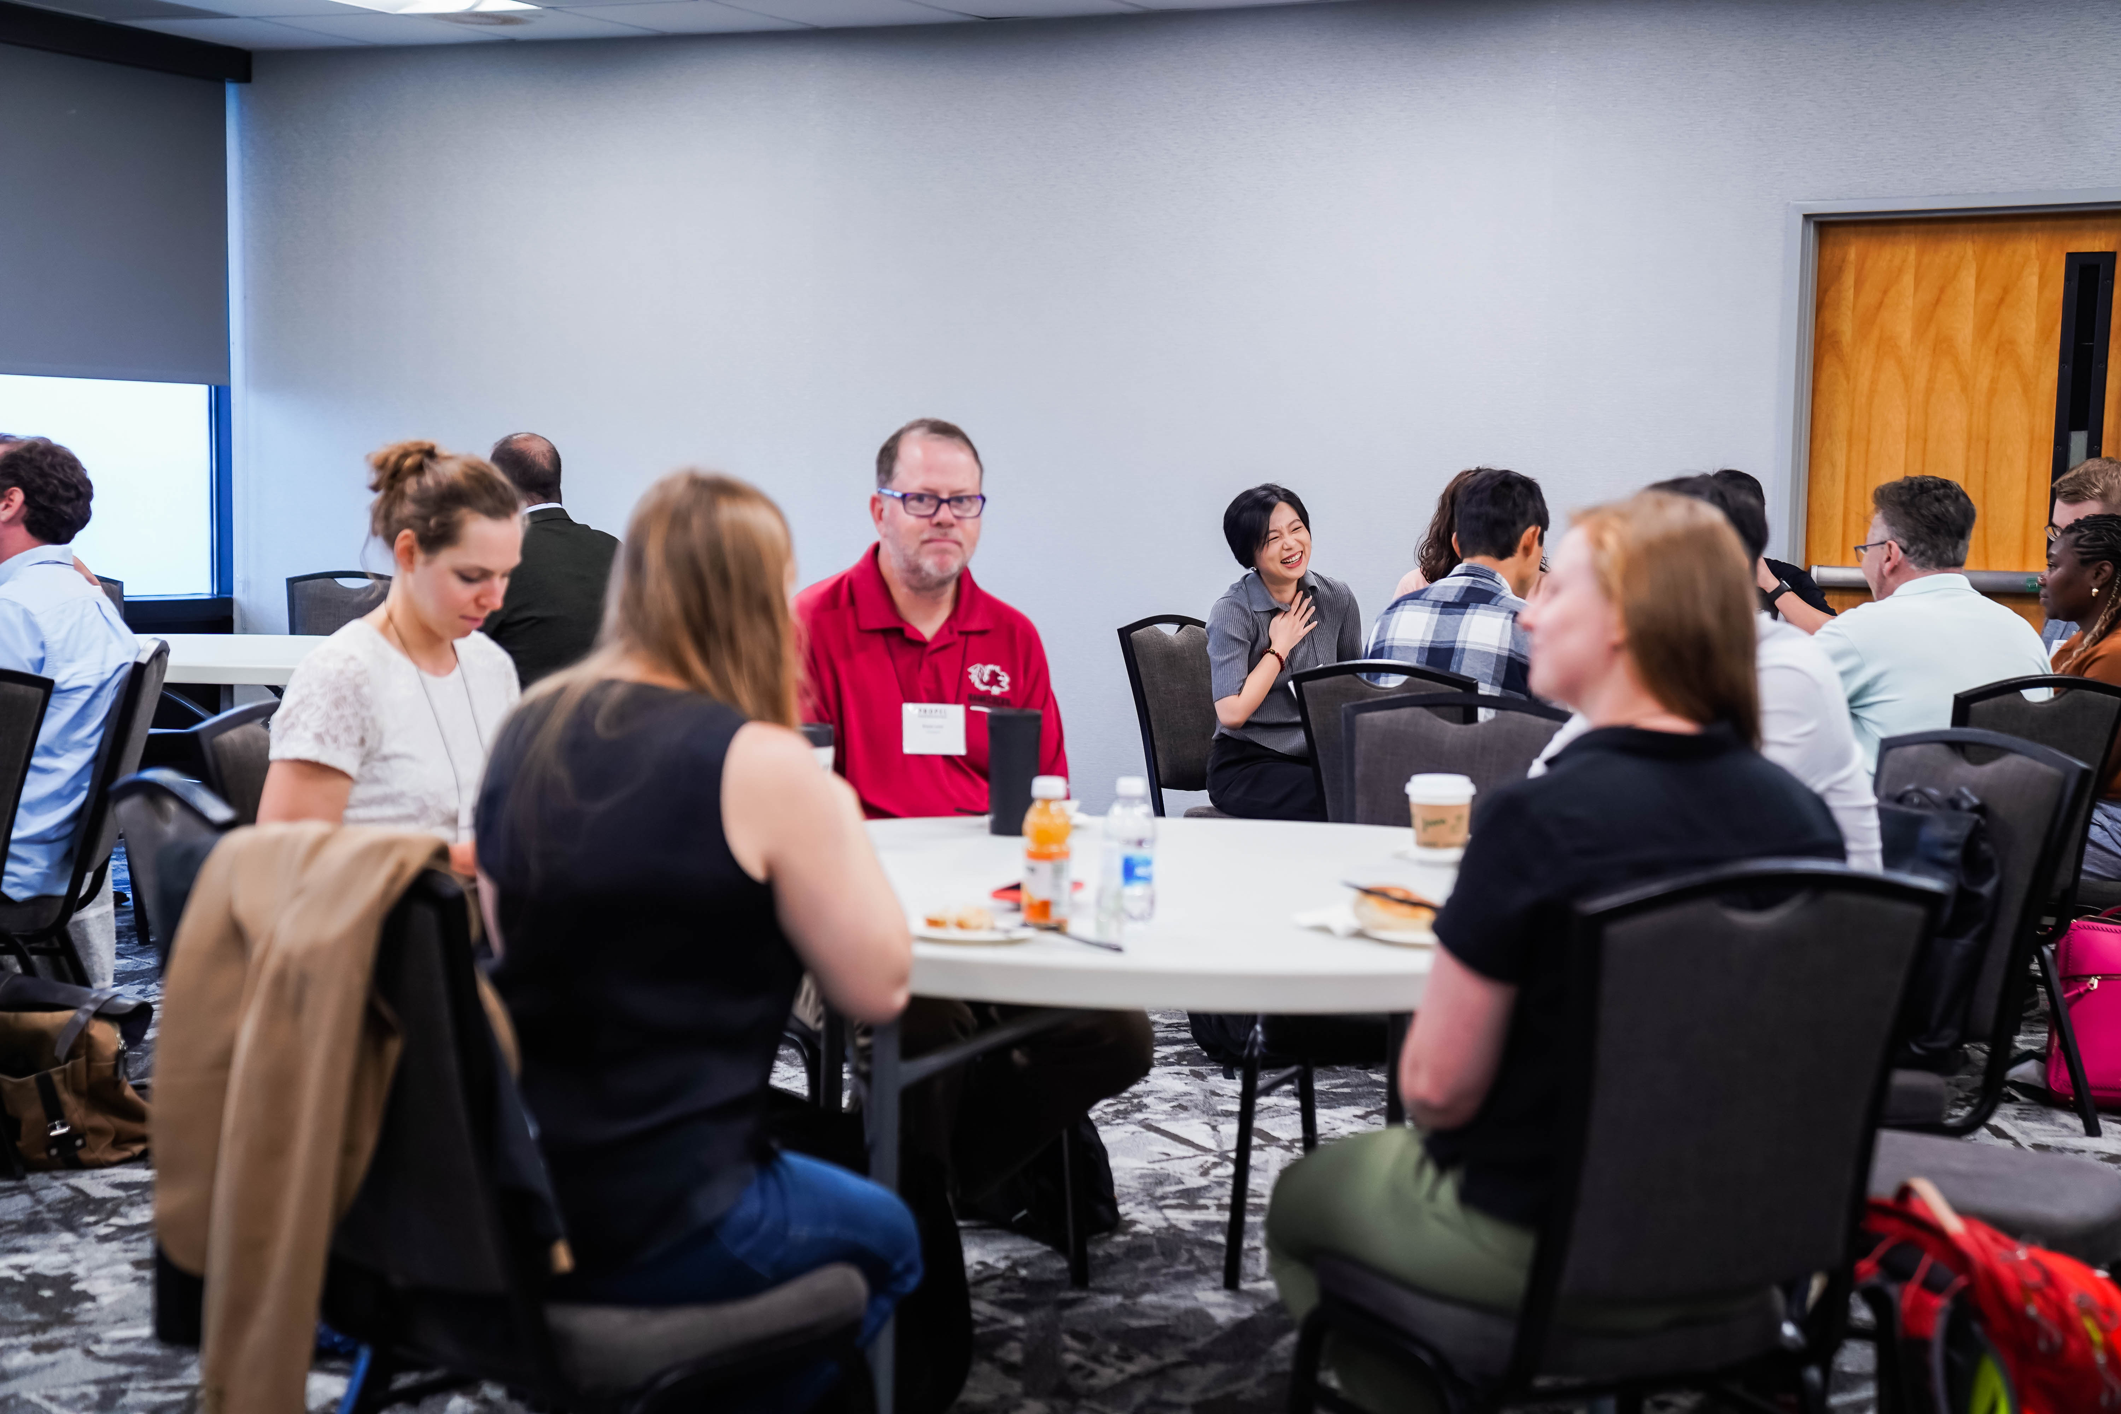
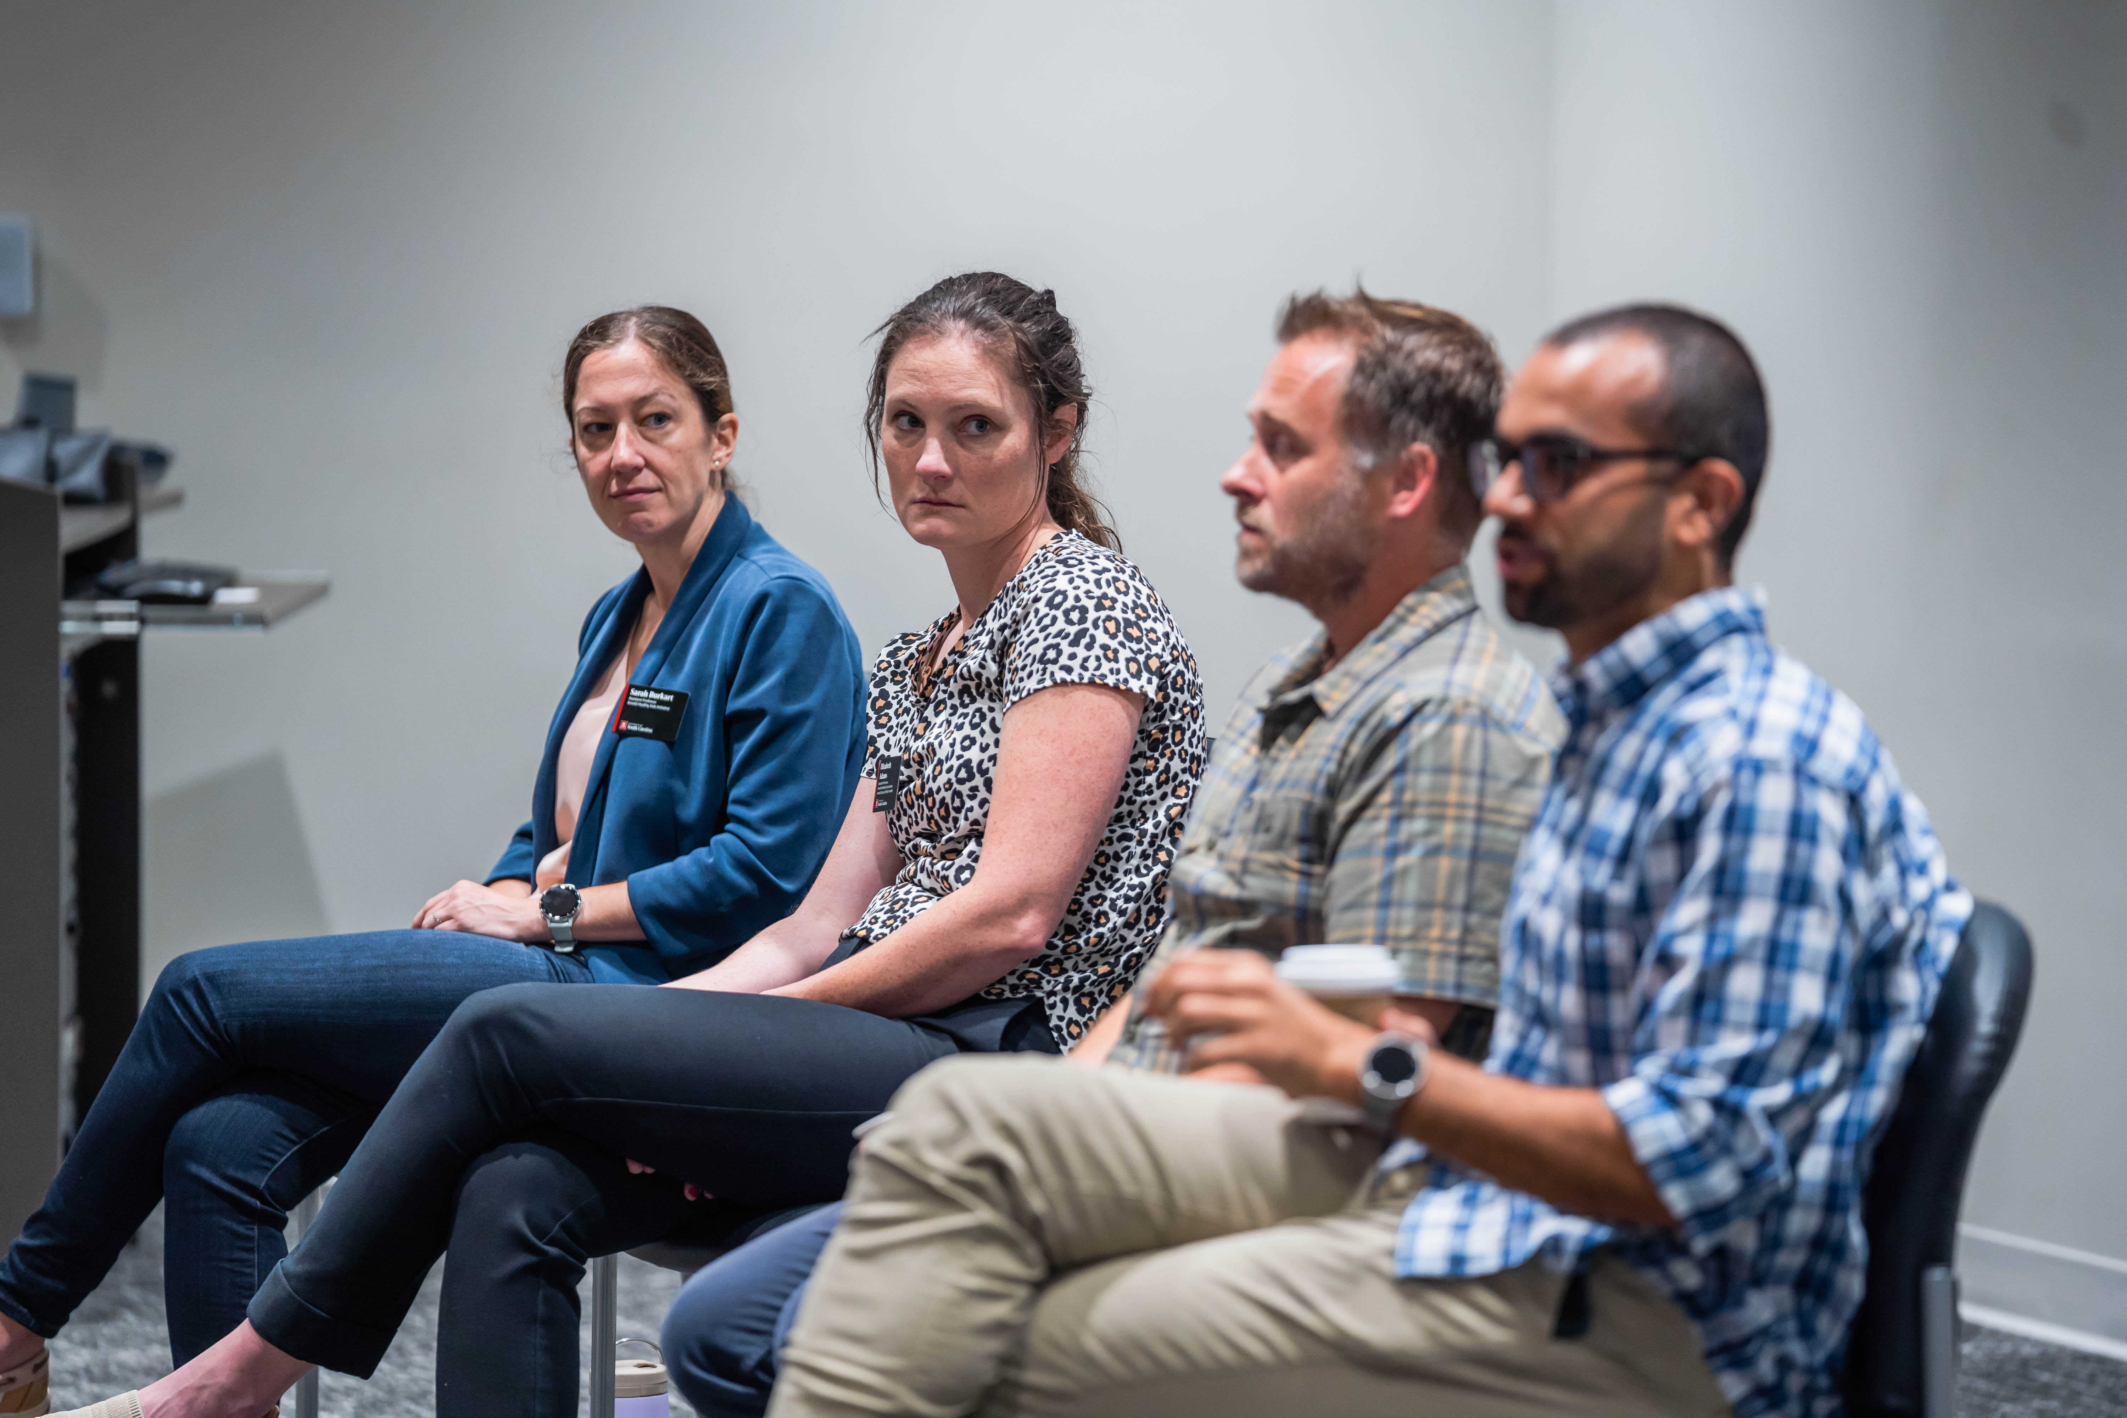
Getting Started:
Networking & Collaboration
Research Training Programs

Slide 8
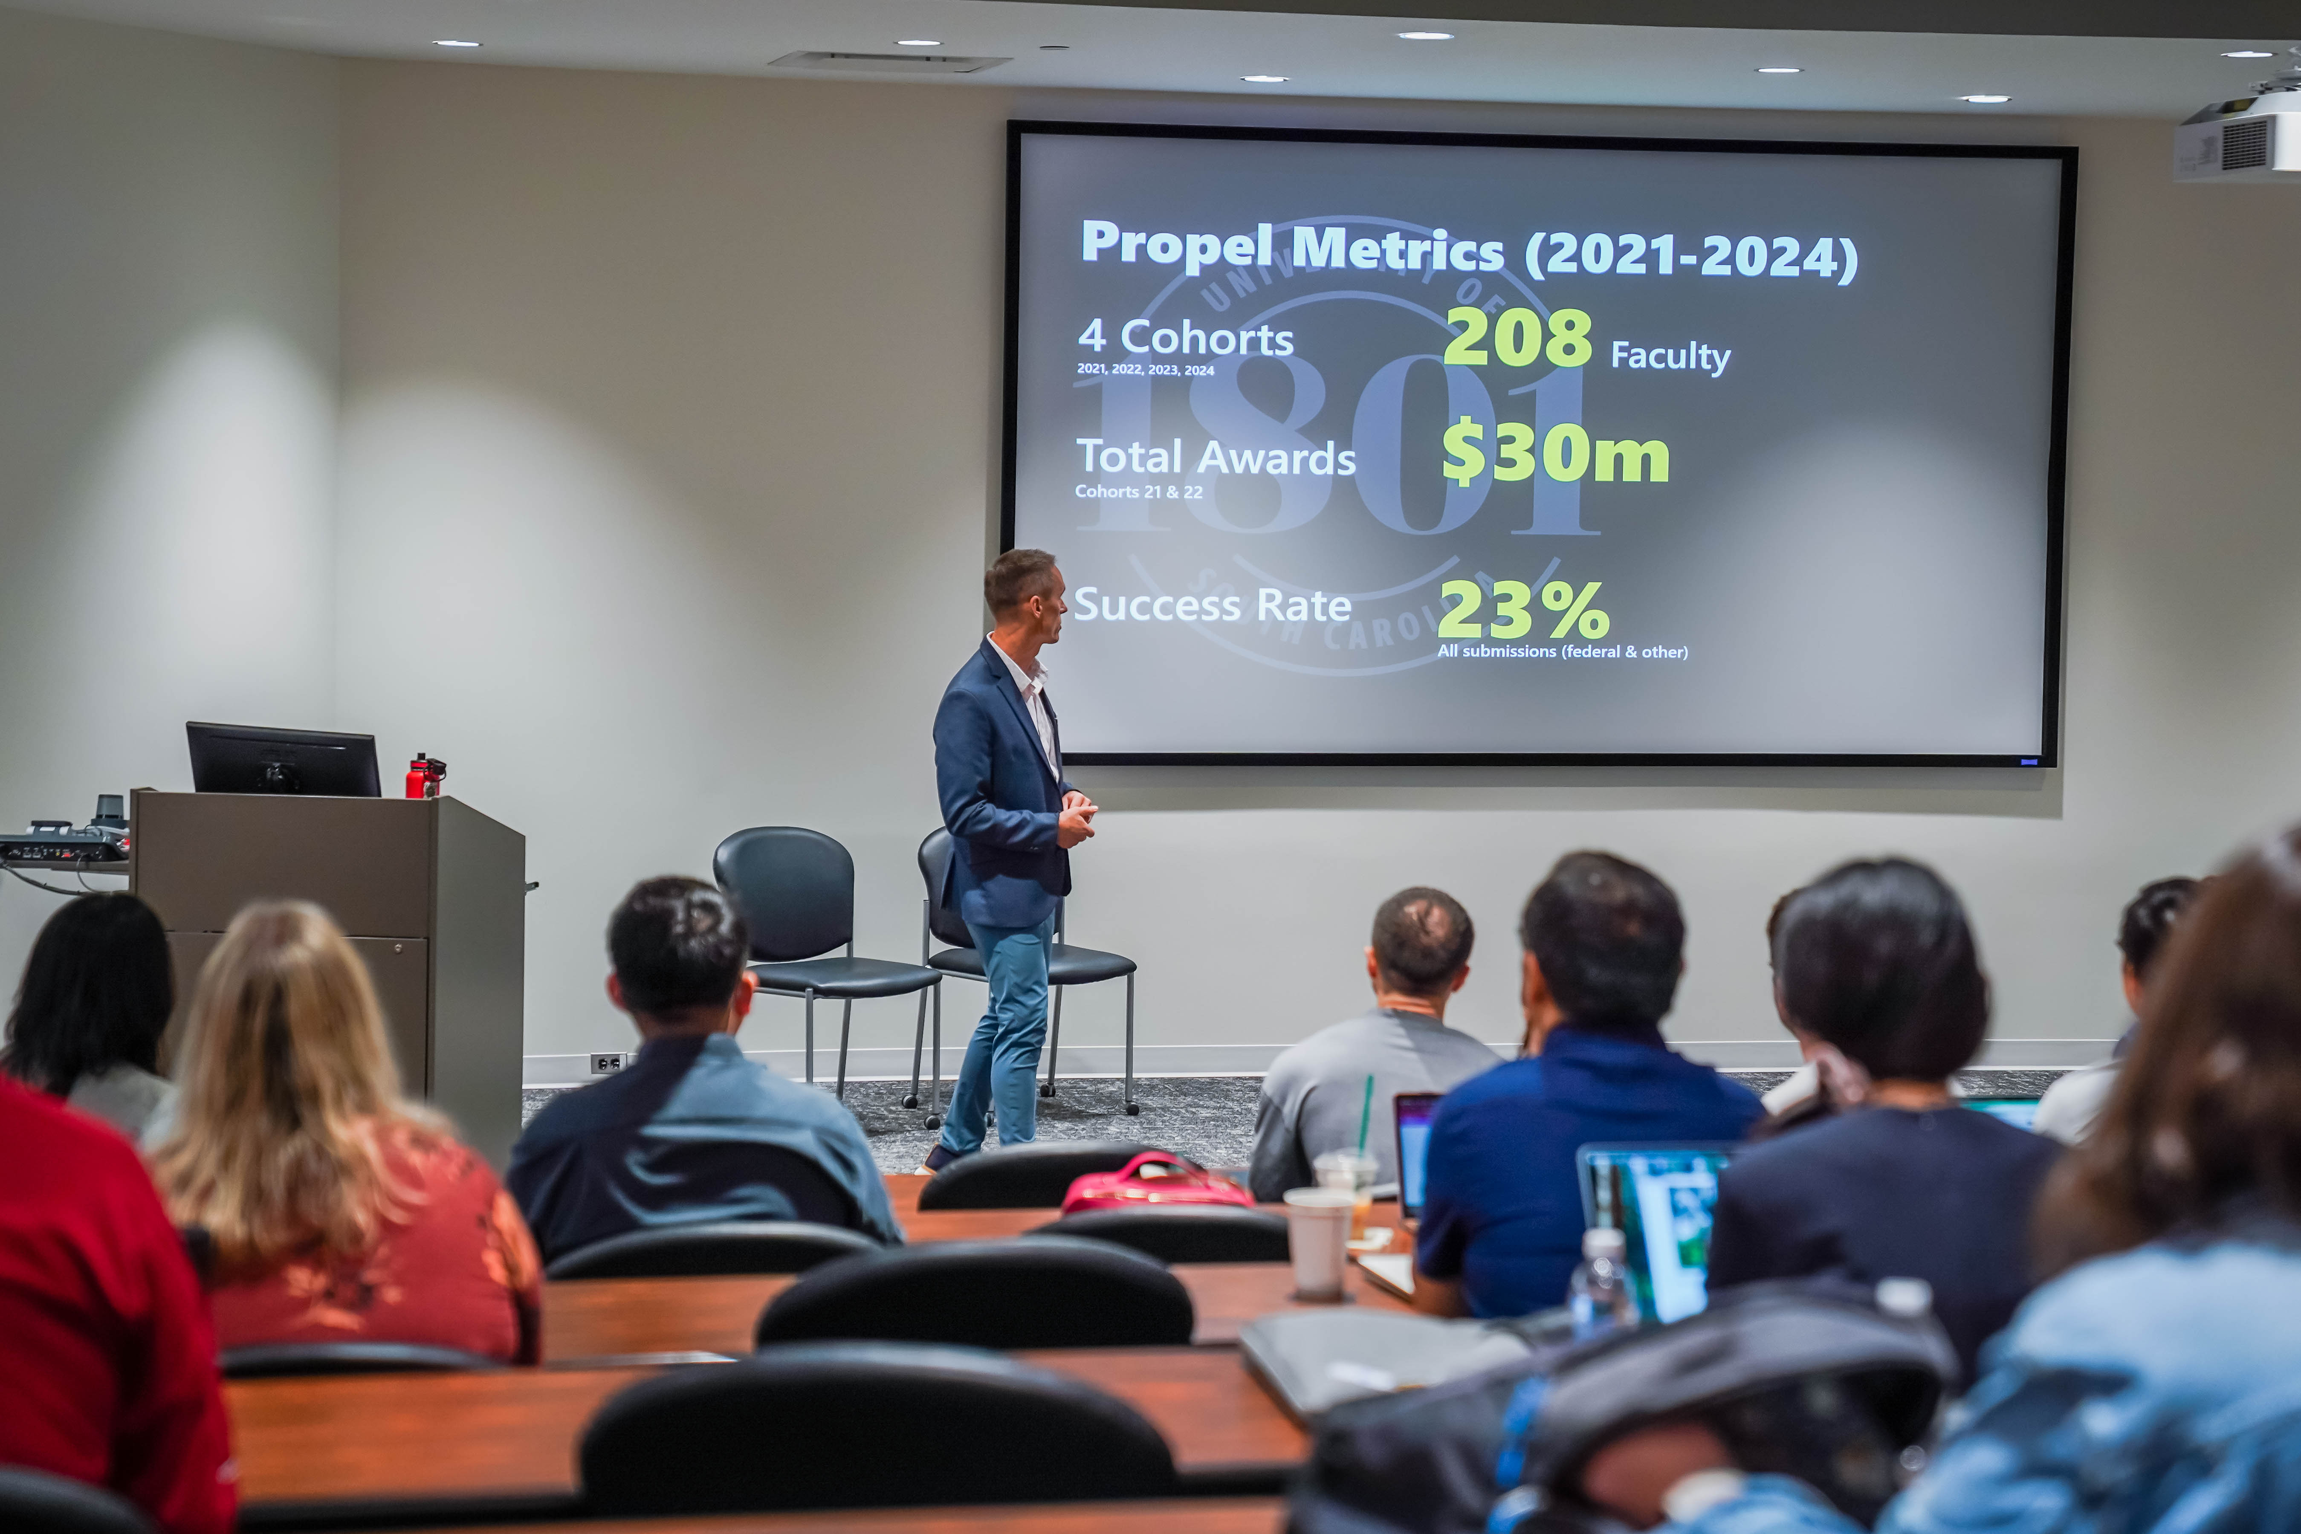
Research Training & Education
Faculty Programs:
Our comprehensive training programs cover everything you need to know to be a successful researcher at the university, including research policies and procedures, how to write successful grant proposals and ways to connect with other USC researchers.
    Propel Mentorship
    Agency Workshops
    Insights Panels
    Special Topics
    Research Operations

Slide 9

Find funding for research
Funding Navigator Tool
Federal Funding Webpage
Internal Funding
    ASPIRE
    RISE
    SPARC
    OUR
Limited Submissions
Partnership with Office of Corporate & Foundation Relations

Slide 10
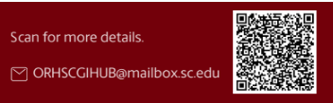
CGI Hub Contact Information
Contact Information:
Director of Proposal Development:
Vanessa Nelson-Reed, vcn@mailbox.sc.edu
Research Development Specialist:
Anne Bailey, bailey25@mailbox.sc.edu
Associate Vice President for Research:
Emily Devereux, devereue@mailbox.sc.edu
Director of Research Training:
Bob Wertz, wertzr@mailbox.sc.edu

Slide 11
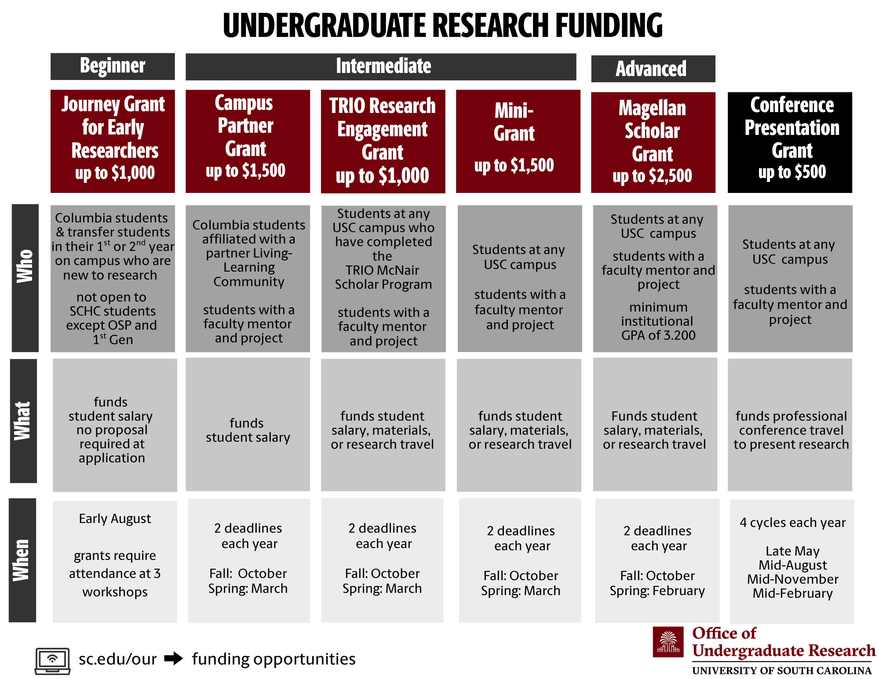
Undergraduate Research Funding

Slide 12
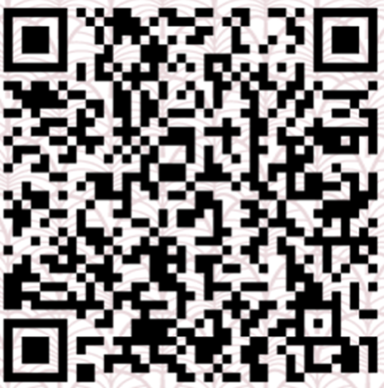
University of South Carolina Research Cores
Contact Information:
Executive Director for Research Cores and Facilities: Bob Price – Bob.Price@uscmed.sc.edu
Director of Finances: Savannah Britz – Savannah.Britz@sc.edu
Associate Vice President for Research: Lumi Bakos – Bakos@mailbox.sc.edu
Website

Slide 13
USC Research Cores
CORE: Collaborative Opportunities for Research Excellence
Shared research resources that provide access to equipment, instruments, technology and specialized expertise
Available to researchers from any part of the university or other organizations
Lab Management Software: Agilent iLabs (Single Sign on with University ID)

Slide 14
OVPR centralized cores
Instrumentation Resource Facility (IRF)
Mouse Experimentation & Germ-Free Core (MEGF)
X-ray Photoelectron Spectroscopy (XPS) Core
Center for Elemental Mass Spectrometry (CEMS)
Mass Spectrometry Facility
Functional Genomics Core (FGC)
Electron Microscopy (EM) Center
Health Evaluation Systems & Technological Information Archive (HESTIA)
Translational Imaging Core
Coming Soon – Organoid and Bioprinting Core

Slide 15
OVPR Affiliated cores
Nuclear Magnetic Resonance (NMR)
Microscopy & Flow Cytometry Core
Infectious Disease Research Core

Slide 16
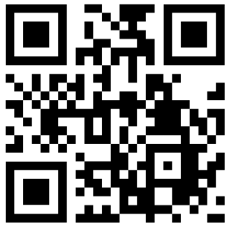
Research Cores Fair
Register for Research Cores Fair 2026
When:
  Friday, September 18, 2026
  9:00 am to 3:00 pm
Where: Pastides Alumni Center

Slide 17

Research Security Awareness & support

Slide 18
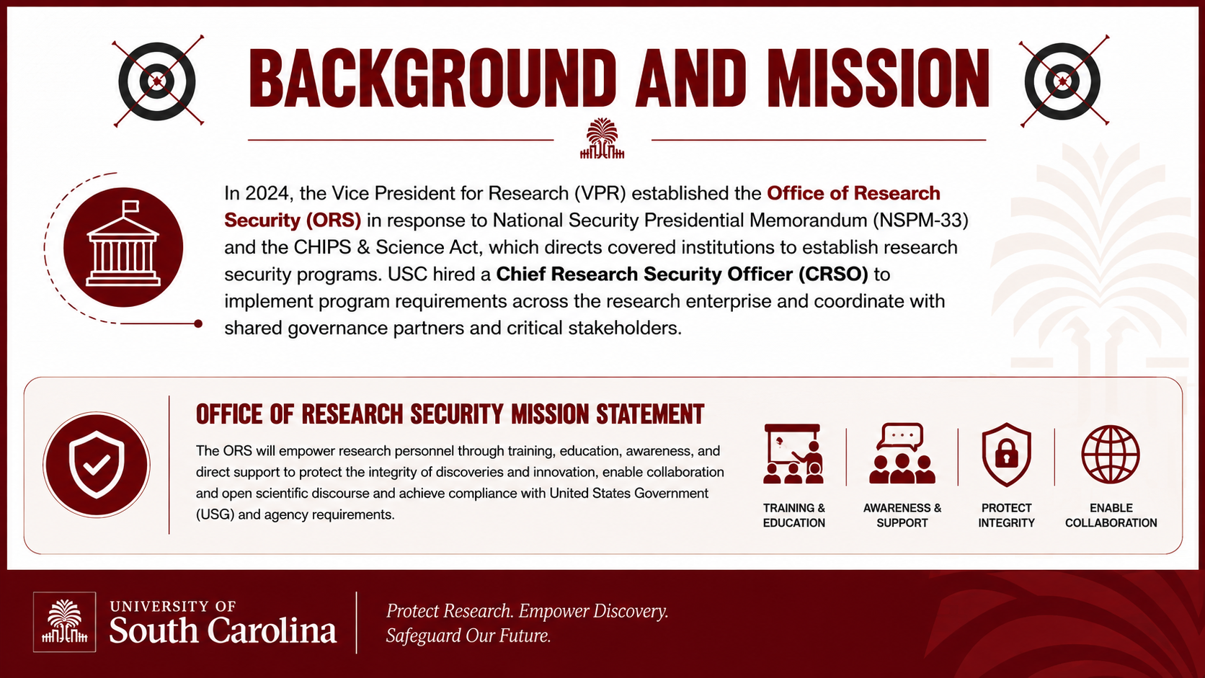
Background and mission

Slide 19
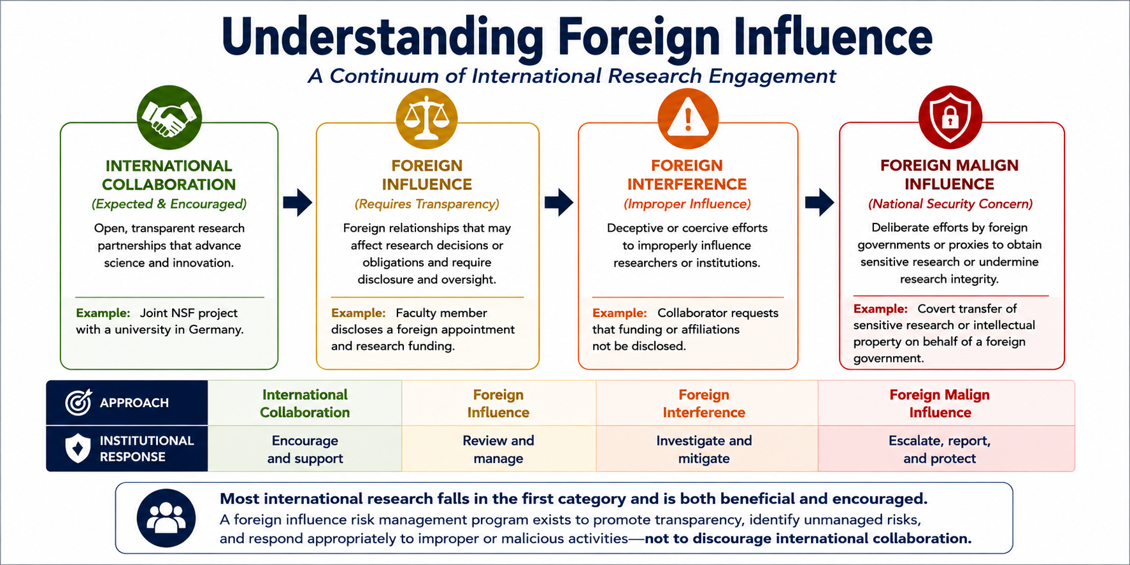
Understanding foreign influence

Slide 20
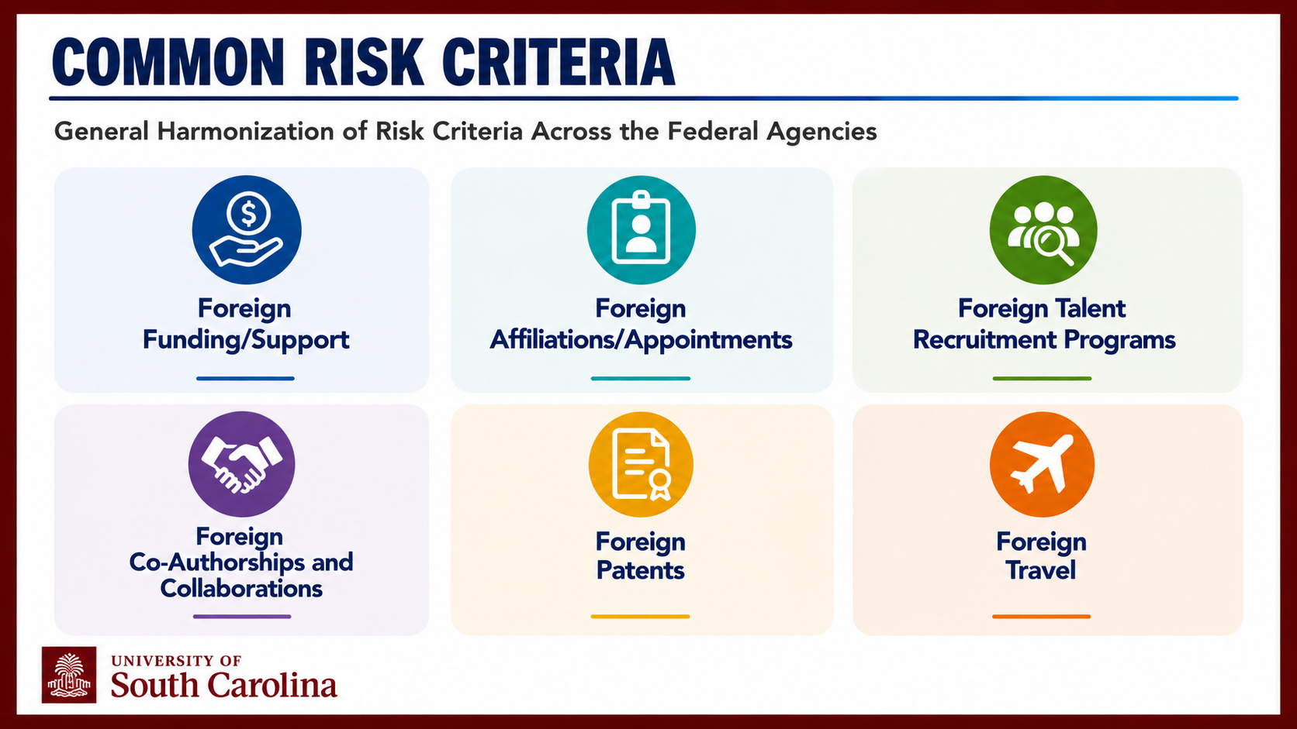
Common risk criteria

Slide 21
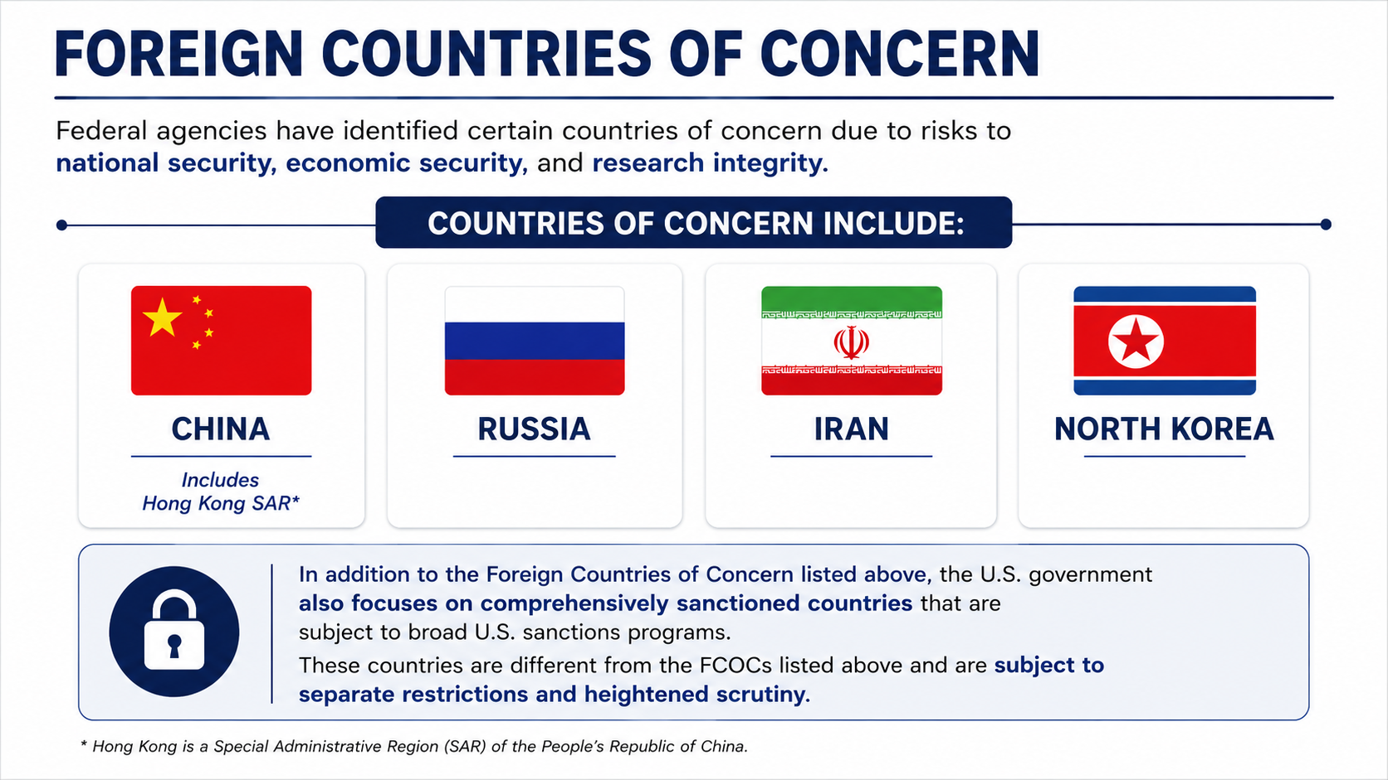
Foreign countries of concern
Notes:
Discrimination – the USG does focus scrutiny on specific countries of concern including China, Russia, North Korea and Iran, due a history of espionage and misconduct. This does NOT mean we cannot collaborate with individuals or entities from those nations, we just need to do the appropriate vetting and due diligence.

Slide 22
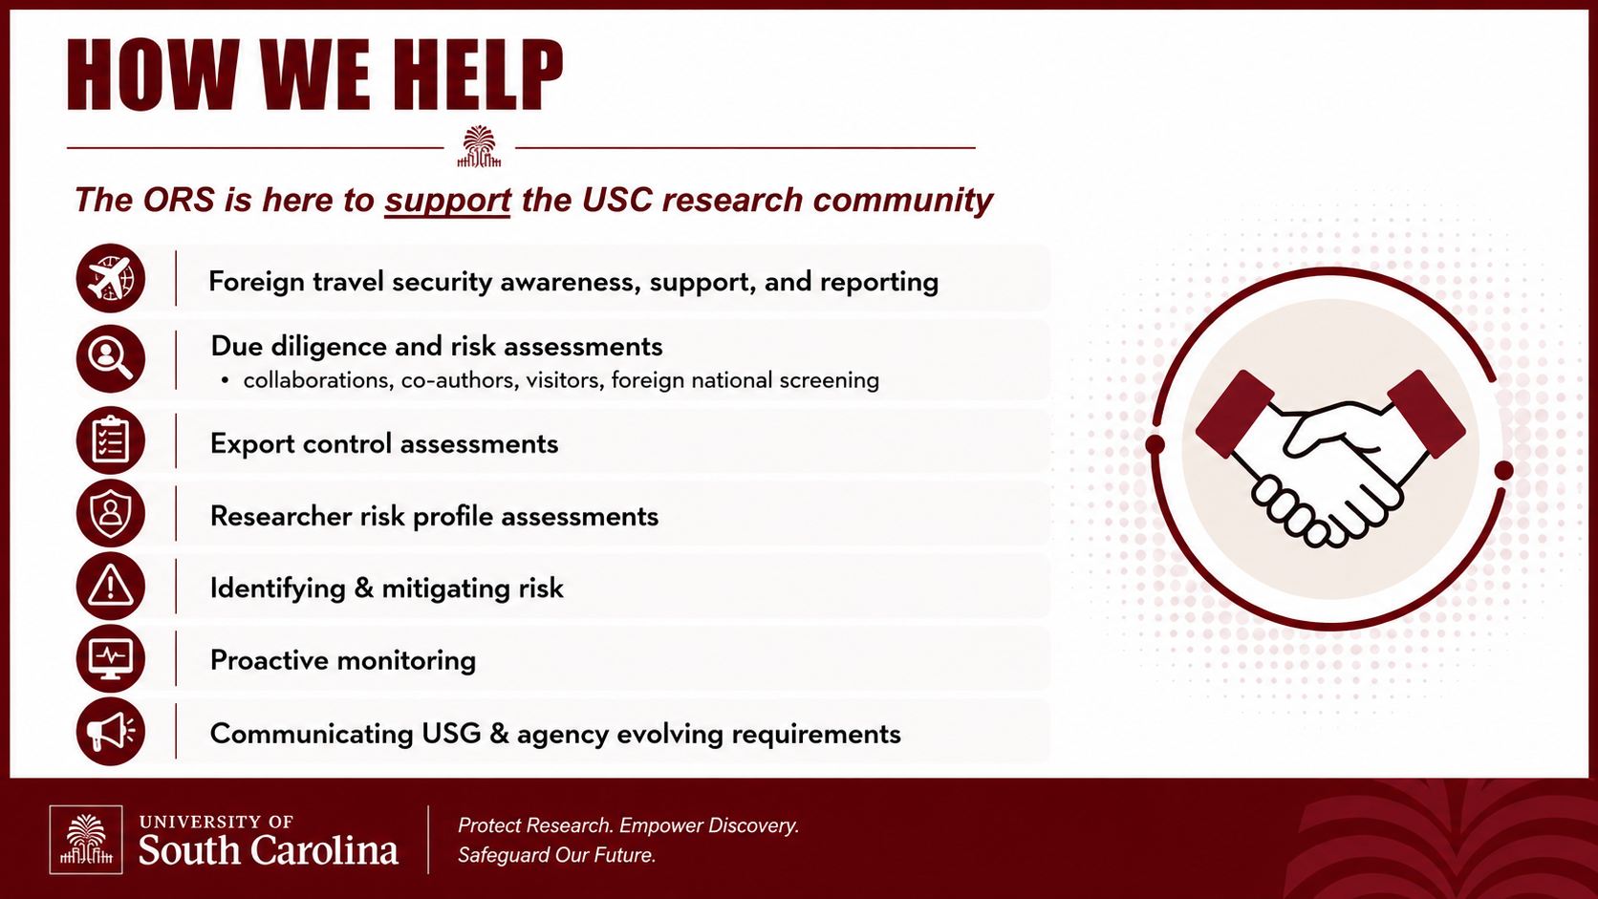

How we help
The ORS is here to support the USC research community
Foreign travel security awareness, support, and reporting
Due diligence and risk assessments
  collaborations, co-authors, visitors, foreign national screening
Export control assessments
Researcher risk profile assessments
Identifying & mitigating risk
Proactive monitoring
Communicating USG & agency evolving requirements

Slide 23
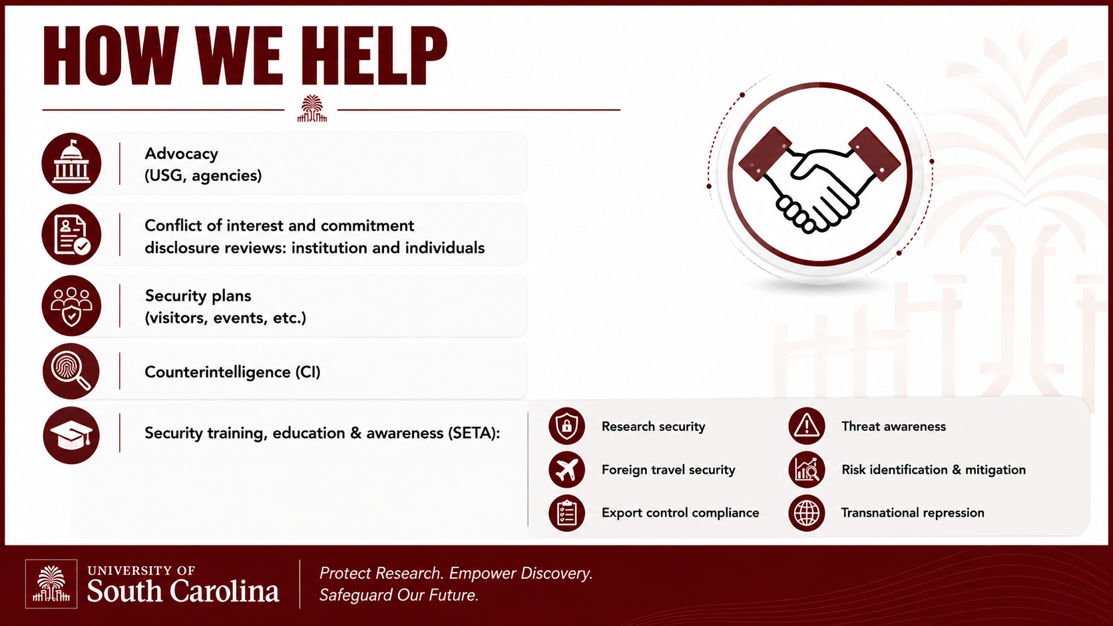
How we help cont
Advocacy (USG, agencies)
Conflict of interest and commitment disclosure reviews: institution and individuals
Security plans (visitors, events, etc.)
Counterintelligence (CI)
Security training, education & awareness (SETA):
  Research security
  Foreign travel security
  Export control compliance
  Threat awareness
  Risk identification & mitigation
  Transnational repression

Slide 24
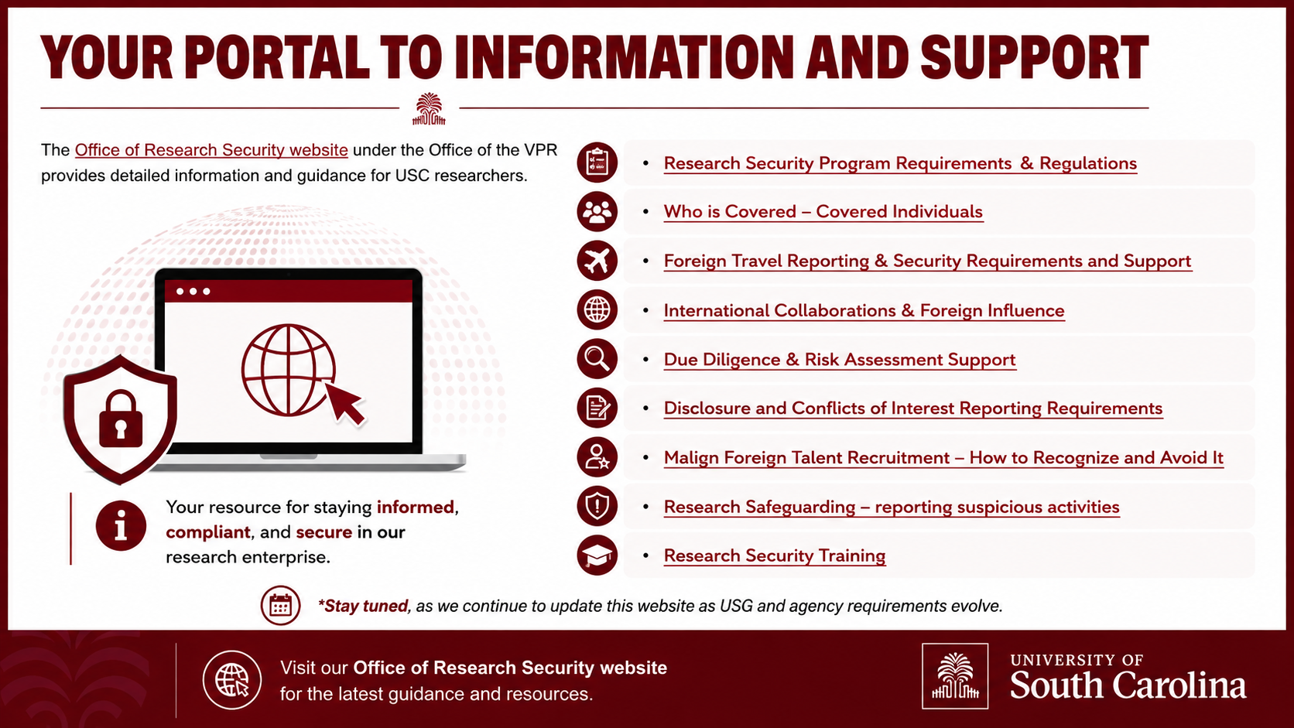
Your Portal to information and support
The Office of Research Security website under the Office of the VPR provides detailed information and guidance for USC researchers.
Research Security Program Requirements & Regulations
Who Is Covered – Covered Individuals
Foreign Travel Reporting & Security Requirements and Support
International Collaborations & Foreign Influence
Due Diligence & Risk Assessment Support
Disclosure and Conflicts of Interest Reporting Requirements
Malign Foreign Talent Recruitment – How to Recognize and Avoid It
Research Safeguarding – reporting suspicious activities
Research Security Training
*Stay tuned, as we continue to update this website as USG and agency requirements evolve.

Slide 25
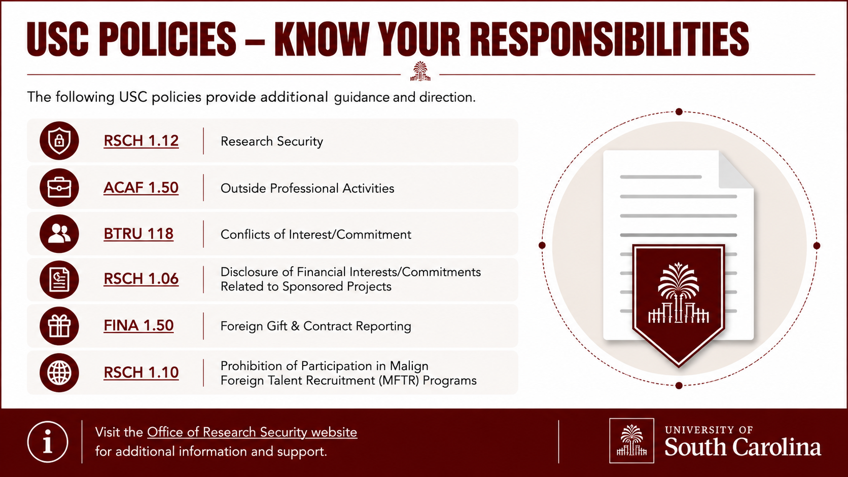
USC Policies – Know your responsibilities
RSCH 1.12 - Research Security
ACAF 1.50 – Outside Professional Activities
BTRU 118 – Conflicts of Interest/Commitment
RSCH 1.06 – Disclosure of Financial Interests/Commitments Related to Sponsored Projects
FINA 1.50 - Foreign Gift & Contract Reporting
RSCH 1.10 – Prohibition of Participation in Malign Foreign Talent Recruitment (MFTR) Programs

Slide 26
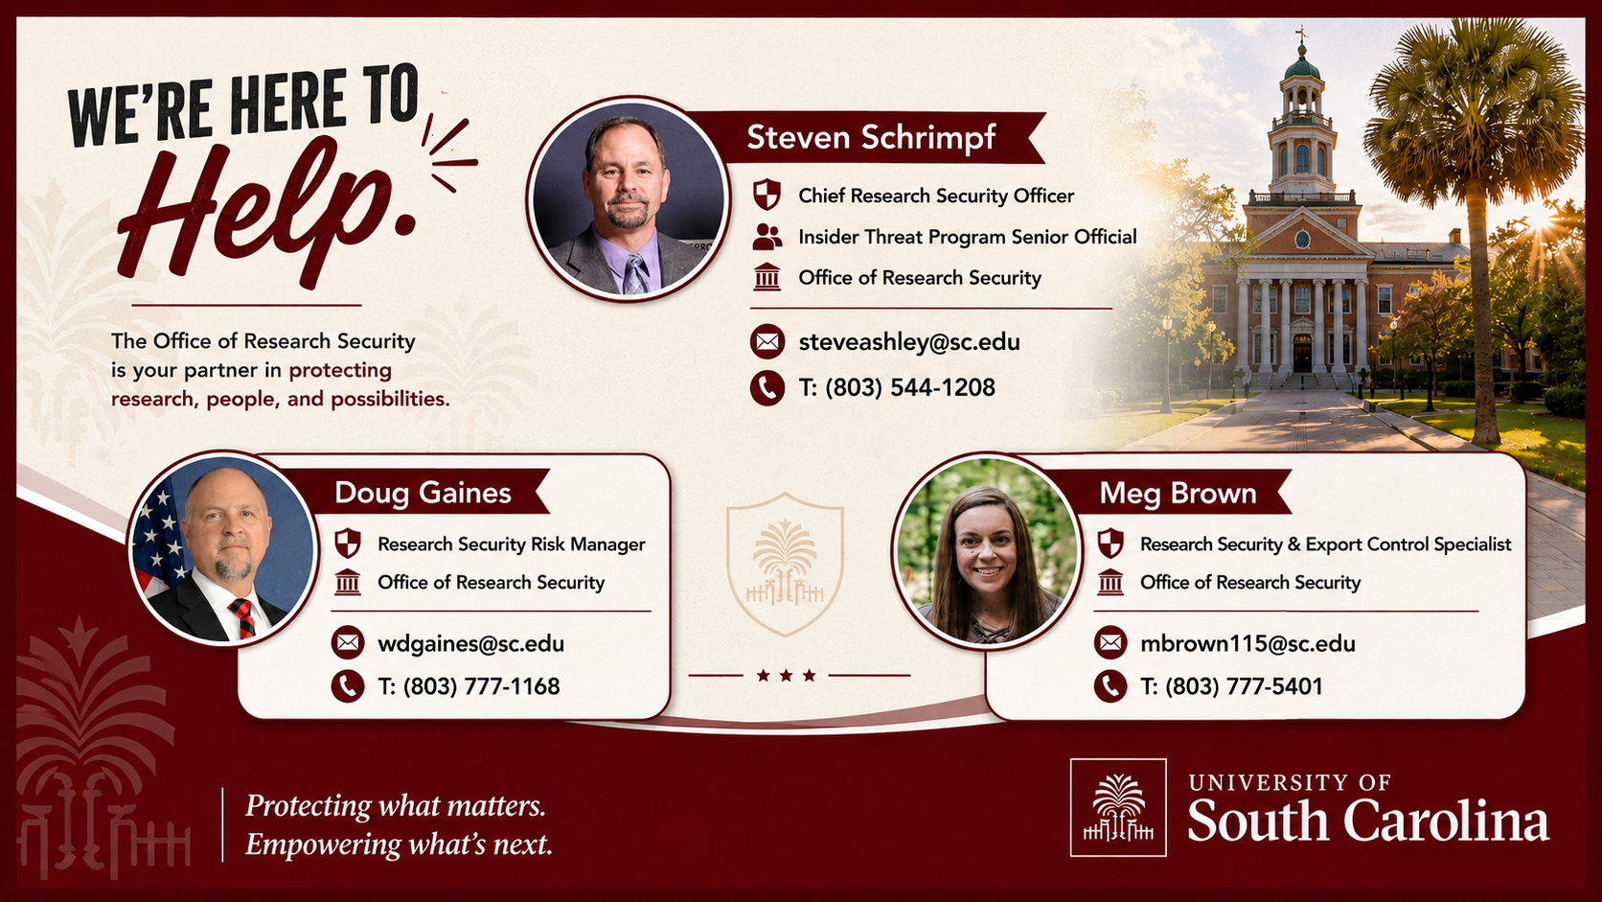
Contact ors

Slide 27
questions?

